Slide 1



Context and Working Modalities
NHSSP Final Dissemination

Slide 2


Context
DFID FA and TA support to 2nd Nepal health SWAp - NHSP2
  £ 57 million financial aid
  £ 20 million technical assistance
Aim: to improve the health and nutritional status of the Nepali population, especially for the poor and excluded, by:
  increasing access to and utilisation of quality essential health care services;
  reducing cultural and economic barriers to access health services,
  and by improving the health system to achieve universal coverage of essential health care services.

Slide 3

Financing and Results for NHSP2
Attributable Results
With DFID support, during NHSP2 (2010-2015) period
432,779 additional unwanted pregnancies averted
798,627 additional women using modern method of family planning
233,873 children immunized
224,028 pregnant women received iron folic acid tablets
124,366 births delivered by nurse, midwives or doctors
£ 20m
£ 57m
Note: Analysis is based on MoHP’s Budget Analysis for NHSP2 and HMIS data for 2010-2015 period.
DFID’s attribution is calculated at 8.3% of national level achievement for related indicators

Slide 4
Management Arrangements
NHSSP – Programme of Technical Assistance on behalf of pool partners
Implemented by Options Consultancy Services Ltd (UK), Oxford Policy Management and Crown Agents
Specialised support from INGO/NGOs incl. SAVE and Helen Keller Int’l
2 phases: 2010-13 and 2013-15

Slide 5
Working Modalities
Embedded TA team
Emphasis on supporting government
Focus on systems, tools and knowledge transfer
Appropriate balance of analysis and implementation support
Joint working: maximize efficiencies; minimize duplication
Support innovation for future scale up e.g. Aama, TABUCS, Social Audit, CEONC services

Slide 6
Working Modalities (cont’d)
Programme documents shared widely as a ‘public good’ including on social media
Performance based deliverables
Flexible and responsive esp. post earthquake
Flexible Technical Assistance Response Fund
A focus on Value for Money
Working ‘beyond the log frame’ – assistance to MoH and pool partners

Slide 7
Thematic Areas
Health policy, planning
Health systems and governance
Essential health care services
Gender equality and social inclusion
Health financing & public financial management
Infrastructure
Procurement
Monitoring and evaluation
Preparations for NHSS (2015-20)

Slide 8
Today’s Presentation
Highlights from selected work steams
Focus on inputs, achievements and possible way forward under NHSS (2015-20)
Assumes knowledge of sector - acronyms!
Folders contains detailed write ups
Pen drives contain all reports and photos
Presentations and video on website next week . www.nhssp.org.np

Slide 9
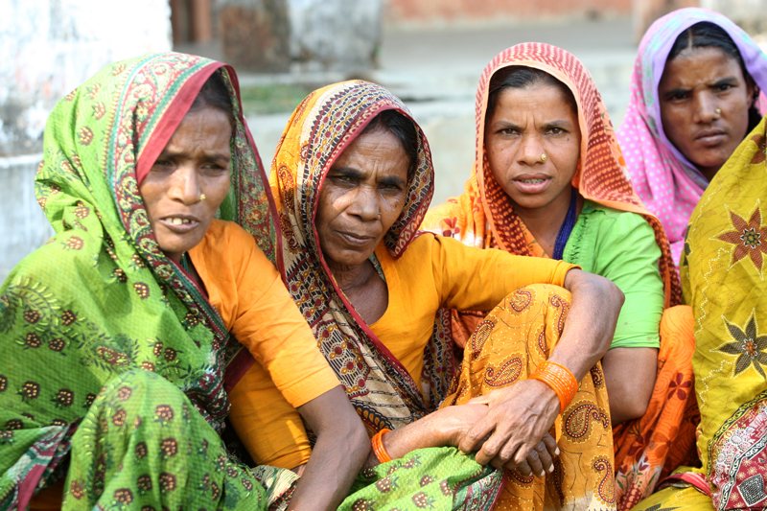

Thank you

Slide 10
Essential Health Care Services
incl. Family Planning
Notes:
NHSSP’s support to improving EHCS delivery is mainly to improve MNH and FP services delivery. Over the last five years NHSSP supported mainly FHD and also to NHTC, MD and CHD in monitoring, reviewing, planning, budgeting programmes and identifying gaps and testing interventions for improving service delivery as well as for reaching unreached population.
I am presenting on behalf of EHCS team based in FHD.
These 3 pillars of EHCS support have been in functionality and quality of CEONC services, managing overcrowding and referral, and reaching remote areas and underserved population. The support have been underpinned by demand and supply side interventions including Aama programme, infrastructure strengthening, decentralised contracting of HR and equipment procurement

Slide 11
EHCS: 3 pillars of support
Functionality and Quality of CEONC Services
Managing overcrowding and referral
Reaching Remote Areas and underserved
Demand-side: Aama cash transfers
Supply-side: Infrastructure strengthening; decentralised contracting of HR and equipment procurement
Notes:
My presentation will cover the work of EHCS/FP team and supporting partners
NHSSP’s support to improving EHCS delivery is mainly to improve MNH and FP services delivery. Over the last five years NHSSP supported mainly FHD and also to NHTC, MD and CHD in monitoring, reviewing, planning, budgeting programmes and identifying gaps and testing interventions for improving service delivery as well as for reaching unreached population.
Among others, these Three 3 pillars of EHCS support - functionality and quality of CEONC services, managing overcrowding and referral, and reaching remote areas and underserved population. The support have been underpinned by demand and supply side interventions including Aama programme, infrastructure strengthening, decentralised contracting of HR and equipment procurement

Slide 12
Functionality and Quality of CEONC Services
CEONC Study – created evidence about gaps in service provision and led to:
  CEONC Fund (in AWPB)
  Service providers production (eg. DGO, ASBA, AA)
  CEONC Mentor
Post-earthquake support to CEONC in affected districts
Notes:
In 2012, NHSSP supported a study on “ readiness of CEONC services” in 18 district hospitals. The study created evidence on gaps in service provision and led to:
gradual expansion of CEONC fund to districts and referral hospitals
Enhancement of CEONC providers productions (DGO, ASBA, AA, Blood transfusion technician training)
Introduction of CEONC mentor in 2013.
This has resulted in rapid expansion of CEONC services from 39 districts in 2010 to 67 districts in 2015 and better management of CEONC services.
Immediately after the April/May Earth quake, NHSSP also supported 14 severely affected districts for resuming and continuation of CEONC services at district hospital level.
As part of support to improving quality of care as required by NHSP 2, NHSSP also supported piloting Hospital quality improvement process (HQIP) in Taplejung and Hetauda hospitals and implementing checklist to improve pre-discharge post-partum care of institutional deliveries in Banke district. FHD has revised these quality improvement tools and processes and planned to scale up in two district hospitals in this FY.

Slide 13
CEONC Expansion (2010-15)
HUMLA
DARCHULA
BAJHANG
MUGU
BAITADI
BAJURA
DADEL-
DOTI
JUMLA
DHURA
ACHHAM
KALIKOT
DOLPA
KANCHAN-
DAILEKH
MUSTANG
PUR
KAILALI
JAJARKOT
SURKHET
RUKUM
MANANG
BARDIYA
SALYAN
B
MYAGDI
KASKI
GORKHA
ROLPA
A
G
L
U
N
G
PARBAT
LAMJUNG
RASUWA
BANKE
PYUT-
GULMI
DANG
HAN
SYANGJA
TANAHU
SINDHU-
AGARKAHN
PALPA
NUWAKOT
PALCHOK
DOLAKHA
DHADING
KATHM
P
SULUK-
KAPILBASTU
RUPAN-
NAWAL
BHAK
A
HUMBU
SANKHUWA-
CHITWAN
H
SABA
DEHI
PARASI
H
MAKAWAN-
LALIT
C
TAPLEJUNG
KAVRE
E
M
PUR
A
R
OKHAL-
PARSA
SINDHULI
DHUNGA
KHOTANG
TERHA-
BARA
SARLAHI
BHOJ-
THUM
PANCHTER
RAUTAHAT
MAHO-
PUR
DHAN-
TARI
DHANUSA
UDAYAPUR
KUTA
ILAM
SIRAHA
SAPTARI
SUNSARI
MORANG
JHAPA
Notes:
This, together with support from various partners, we now have 67 districts with CEONC services from 39 districts in 2010.
However, functionality in terms of providing C section service fluctuates.
In end of June 2015 we had 61 districts with a functioning CEONC site, and by end of July 2015 (beginning of the FY) we had only 49 districts with a functioning CEONC site.
Due to annual contracting of providers and unavailable CEOC fund at the beginning of the FY.
After the Earth quake, we also supported resuming and continuation of CEONC services at EQ affected districts.

Slide 14
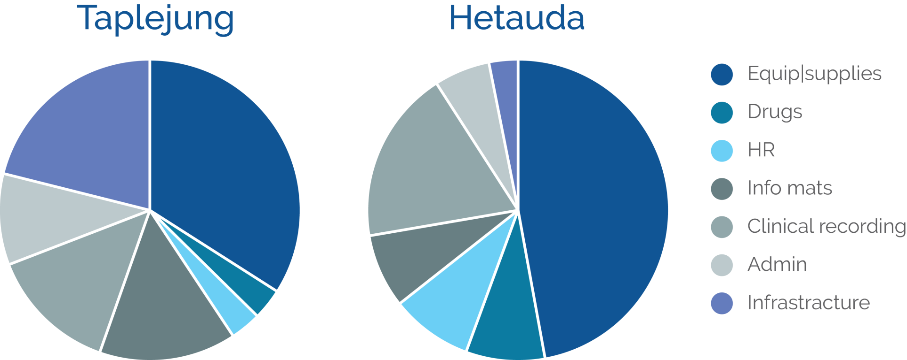
Functionality and Quality of CEONC Services
Hospital Quality Improvement Process
PNC checklist
Notes:
In HQIP, staff are trained to do self assessment of MNH service availability and delivery process and planning action based on findings. The final evaluation found that staff appreciated the process and tools, they also found it easy to implement and the visual traffic light presentation of the assessment motivate them for better quality management.

Slide 15
Managing Overcrowding and Referral
Study on responding to increased demand for institutional delivery:
  Immediate actions to reduce overcrowding at referral hospitals
  Piloting of strategic birthing centres which provide 24/7 services and free referral for complicated deliveries
  Plans for normal delivery units at/near referral hospitals
Post-earthquake support for free referral from birthing centres to district hospitals
Notes:
On the request of the FHD, NHSSP support a study on responding to increased demand for institutional deliveries in six referral hospitals in 2013.
The study highlighted the problems of overcrowding and recommended immediate and short term measures for coping with the overcrowding and long-term measures to address the problems.
As Immediate coping strategy, FHD provide budget in AWPB to referral hospitals for recruiting critical HR, purchasing critical equipment, and expansion of beds in available space.
As part of Long-term strategy –
strengthening strategic birthing centres and referral link between these BC and referral hospital to share the load of institutional deliveries and
For catering women who would like to go directly to the referral hospital, a birthing unit has been recommended. Advocacy from FHD resulted in MOH and its partners commitment to build birthing unit at a number of referral hospitals
NHSSP has been providing technical support to FHD to implementing strategic birthing centre approach in Banke districts and providing evidences and discussion points for addressing overcrowding at referral hospitals.
Our experience in supporting these referral hospitals and strengthening strategic birthing centres and referral link in Banke district provide evidences for developing strategies for free referral from birthing centres to district hospitals in EQ affected districts.

Slide 16
Reaching Remote Areas and the Underserved
Remote Area Maternal and Newborn Pilot (RAMP)
Family Planning pilots to reach unserved populations
Remote area safe abortion services (IPAS)
Context specific planning for newborn care
Notes:
One of the NHSP 2 objectives is to reach underserved and unreached population . NHSSP supports FHD in identifying gaps, designing and piloting interventions for reaching unreached population in MNH and FP services. To date we have supported a number of pilots in family planning, safe abortion, new born care and MNH access in remote areas.

Slide 17
Remote Areas Maternal and New born Health Pilot Project, (RAMP), Taplejung district
Purpose:
To inform government plans for working in remote areas of Nepal in NHSS (2015-20) by identifying concrete lessons and strategies for increasing access to and the uptake of MNH services in remote areas.
Notes:
The primary research questions are:
1. How can essential MNH services be made available and demand side interventions for MNH delivered in remote areas?
2. Can supply-side interventions alone increase the use of and access to MNH services?
3. Can demand-side interventions complement supply-side interventions to work together to promote greater accessibility and use of MNH services and accountability in providing them?

Slide 18
Three types of RAMP intervention packages compared
Package 1 | Package 2 (4 VDCs) | Package 3 (5 VDCs)
 |  | Demand side interventions: BCC, Emergency fund Stakeholders mobilisation and advocacy.
 | Supply side health facility interventions: Earmarked MNH Fund, ANM skill enhancement, HFOMC strengthening.
District wide interventions: District wide coordination for resource mobilisation and drugs distribution District hospital services, Obstetric first aid to paramedics
Notes:
This pilot has three levels of interventions: district wide interventions, supply side interventions and demand side interventions
We evaluated outputs and outcome level indicators. We found impressive improvement at output level, but less so obvious improvement for outcome level indicators. I would like to show a few slides of the findings.

Slide 19
Expansion of Services
RAMP: Progress Towards Achieving Outputs
 | Proposed plan | Achievements
1 | Upgrade 2 BCs to BEONCs | 4 BEONCs
2 | Strengthen 2 and establish 1 BC | 3 BCs
3 | LARCs in all BEONC/ BCs | LARCs in 4 BEONCs
4 | MA services in all BEONC/BCs | Main 2 BEONCs
Total HF – 10
Notes:
This pilot shows that it is Possible to expand services in remote areas
However, Intensive efforts needed to make the health facility functional for providing the defined service package, and sustained efforts of support will be necessary to continue these services in remote areas.
What made this possible?
Flexible fund (earmarked fund at DHO) improve continuity of SBA (ANM) at BC bridging gaps due to budget release problem. The flexible fund also facilitate local resource mobilisation
Placement at training sites (from BC) increases staff motivation, enhance knowledge and skills, lead to provision of service including emergency obstetric care
Strengthening HFOMC should be a component of facility strengthening

Slide 20
RAMP: Improved Quality of Care
13 quality domains scores of RAMP health facilities with BEONC/BC (6 health facilities)
Notes:
This is the scores achieved on quality assessment by staff
appreciated by HF staff and also the visual display has prompted HFOMC to respond the need of service providers.

Slide 21
RAMP > Improved Governance (HFOMC)
 | Institutional capacity, HFOMC empowerment |  | Health facility management |  | Health Service provision
 | Beginning | End | Beginning | End | Beginning | End
Change HP | 8 | 14 | 7 | 13 | 9 | 11
Sobuwa SHP | 6 | 9 | 2 | 10 | 5 | 9
Sablakhu HP | 6 | 9 | 3 | 9 | 7 | 12
Limbhudin SHP | 0 | 13 | 2 | 11 | 4 | 12
Angkhop SHP | 2 | 9 | 2 | 8 | 3 | 11
Lingkhim HP | 3 | 13 | 8 | 13 | 6 | 16
Tapethok SHP | 2 | 10 | 3 | 14 | 6 | 12
Khajenim SHP | 2 | 11 | 2 | 11 | 5 | 13
Thinglabu HP | 3 | 9 | 8 | 11 | 7 | 11
Samthakra SHP | 1 | 10 | 4 | 11 | 4 | 9
Average | 3.3 | 10.7 | 4.1 | 11.1 | 5.6 | 11.6
Notes:
Strengthening capacity of HFOMC by training, frequent follow up and using capacity self assessment tools (NHTC) and action planning resulted in improved capacity of HFOMC
However, Frequent transfer of staff at DHO and HF levels in remote areas was a major treat to service improvement as well as for governance of health facilities.
What made this possible?
Flexible fund (earmarked fund at DHO) improve continuity of SBA (ANM) at BC bridging gaps due to budget release problem. The flexible fund also facilitate local resource mobilisation
Placement at training sites (from BC) increases staff motivation, enhance knowledge and skills, lead to provision of service including emergency obstetric care
Strengthening HFOMC should be a component of facility strengthening
Intensive efforts needed to make the health facility functional for providing the defined service package, and sustained efforts of support will be necessary to continue these services in remote areas.

Slide 22
Proportion of recently delivered women with institutional delivery
RAMP > Improved Outcomes
Notes:
We found improved service use in ANC, compliance to Iron folic acid, institutional deliveries, and in new born care. We also found improved service delivery and use in compare VDCs in some indicators.
Package 3: dalit and illiterate
Women within 30 minutes – has much higher institutional deliveries (50-90%)
However, Community behavior changes such as support and encouragement from mother in law was not yet observed in evaluation. This may be due to very short intervention period.

Slide 23
MNH in Remote Areas: Way Forward
Programme:
District level planning and replicating Taplejung approach in remote districts for reaching women and children in remote areas
Long term support to district level
Focus on inter-sectoral coordination
System:
Retention strategy for remote area staff
Extreme remote areas – need to explore alternative service providers
Notes:
Based on lessons learned from Tapljung remote areas MNH pilots, we can recommend at programme levels:
District level planning and replicating Taplejung approach in remote districts for reaching women and children in remote areas (HFOMC, SBA placement, onsite mentoring using QIP tool, earmarked fund)
Long term support by partners will be necessary in remote districts
Focus needed to inter-sectoral coordination and the opportunity for synergy with social mobilisation and governance programmes - including transport, communication systems and education line agencies (advocacy for remote focused at central and district level)
At system level:
MOH needs to have staff Retention strategy for remote area
For extreme remote areas - Contracting out services in the most remote VDCs/ districts should be considered.

Slide 24
Reaching the Unreached in Family Planning
Three pilots underway for improving access to and use of LARCs in remote areas and FP use among postpartum women
FP/EPI integration:
  Kalikot pilot showed that FP service could be integrated in EPI clinics without hampering EPI service provision
  In Sindupalchok, 29% of post partum mothers attending group health education at EPI clinics accepted and use family planning methods.
  Appropriate for remote district where EPI service case load is not high.
  FHD has planned to scale up this approach in four district (Parbat, Rukum, Doti and Jajarkot) AWPB-2072/73.
Notes:
Long acting reversible contarceptives

Slide 25
Reaching the Unreached in Family Planning
Visiting Providers:
  VP in Ramechhap increased availability of LARCs at BCs and non-BCs
  1103 women received LARCs service (>5,500 CYP)
  VP approach in line with NHSS district mentor approach
Voluntary Surgical Contraceptive Plus (VSC plus)
  VSC mobile service with LARCs at regular interval at defined sites enhanced availability and use in Darchula and Baitadi.
  227 VSC services (minilap 146, NSV 81) & 113 LARCs (3,386 CYP)
  These approaches enhanced LARC use among marginalised groups
Notes:
The second pilot is visiting provider in Ramechhap district
VP in Ramechhap districts has increased availability of LARCs at BC by onsite coaching and non-BC by direct provision of LARCS periodically.
1063 women received LARCs service from VP during eleven months periods contributing about 5,500 CYP for the Ramechhap districts.
This approach enhanced LARCs use among marginalised groups.
VP approach is in line with NHSS-3’s district coach/mentor approach of using trained/experience service providers for strengthening and improving quality of care at health facility level
More than 60% of LARC users are Janajati (compare to <50% Janjati representation in the district) and 14% LARC users are Dalit (compare to 10% Dalit representation in the district).

Slide 26
Support to New Born Care
Support to CHD for revision and implementation of CBIMNCI through SAVE and strengthening CEONC and BC services in 3 districts.
Post EQ support to restore HF and FCHV services in Nuwakot and Rasuwa
Notes:
NHSSP also supported CHD in developing and implementation of context specific planning and implementation of newborn care through partner Save the children International. The support also included strengthening CEONC and BC services in three districts.
As immediate response to EQ, SCI also supported for re-establishment of BC services and supporting FCHV and district coordination efforts in Nuwakot and Rasuwa.

Slide 27
Contribution to progress
Availability of CEONC increased from 39 districts in 2010 to 67 (out of 75) in 2015
Number of BC/BEOCs increased from 601 in 2010 to 1785 in 2015
Institutional delivery increased from 35% in 2011 (DHS) to 55% 2014 (MICS)
CS rate > 5%
Notes:
The support to Essential health care services has contributed to increased availability and use of MNH services as targeted by NHSP 2.
WE now have 67 districts with CEONC services and 1785 VDC with BEONC or BC services.

Slide 28
Continuing priorities for NHSS (2015-20)
Increasing access to MNCH and FP services in remote areas and underserved populations – dedicated models and resources
Continuing expansion of CEONC services
Preventing unwanted pregnancies
Improving quality of care to accelerate health impacts
Notes:
Increasing access to MNCH and FP services in remote areas and underserved populations – dedicated models and resources – refining and scaling up piloted interventions on FP and remote areas MNH approaches would be important for reaching underserved population in the next health sector programme.
Continuing expansion and quality improvement of CEONC services as targeted in NHSS 3 (75 districts)
Improving quality of MNH care in health facilities to accelerate health impacts (NHSS quality of care)
Preventing unwanted pregnancies

Slide 29

Aama Surakshya Programme: Connecting Women and Health Facilities

Slide 30
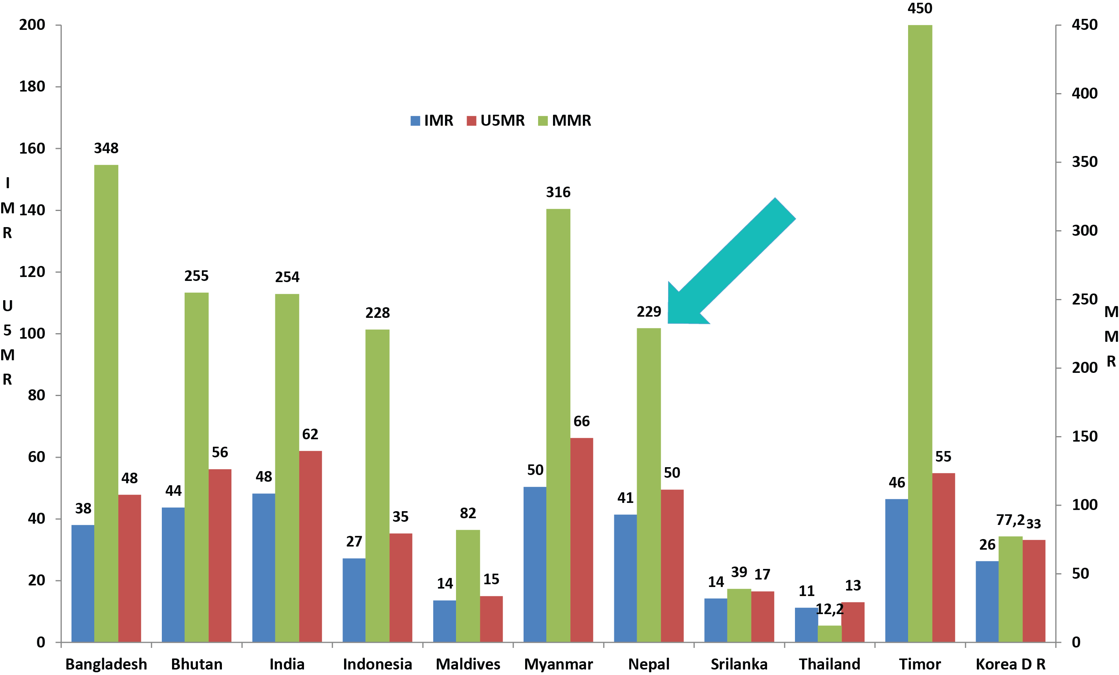
Nepal: Good Relative Progress in Asia
Source: World Bank, 2010

Slide 31
Impressive SMN gains in 20 years
Launch of MIS
Source: NDHS 1996, 2001, 2006, 2011, WHO 2013 and MICS 2014, NHSP 2 target for 2015
Notes:
SM policy 1998 – focuses on access to emergency obstetric care services
SM long-term plan (1997-2017) revised in 2006 focused on expansion of services, demand creation
Legalization of Abortion (2002)
Safe Abortion Service (2004)
SDIP (2006) safe delivery incentive started in 2006 with transport incentive and free delivery in 25 low HDI districts
SBA Policy (2006) and training strategy – now almost 6000 SBA trained
CEONC fund and ANM?SN budget (2008) – now more than 35 sites received support for HR, equipment and repair. More than 1600 ANM/SN recruited
Expansion of BC and CEONC
Safe Blood Policy (2008)
Aama (2009)
Community based – BPP, Misoprostol, Chlorhexidine
MPDR
Overall socio-economic development
Policy and political commitment
Partners‘ support’

Slide 32
Aama Program: Introduction
Coping with the Burden of Cost of Maternal Health Study (2003) identified financial barrier as principal obstacle to women accessing delivery services
Aama Surakchhya Program introduced to reduce financial barrier and increase institutional delivery
Programme has had a positive impact in improving institutional capacity and access to delivery care.
Source: NDHS 1996, 2001, 2006, 2011, WHO 2013 and MICS 2014, NHSP 2 target for 2015

Slide 33
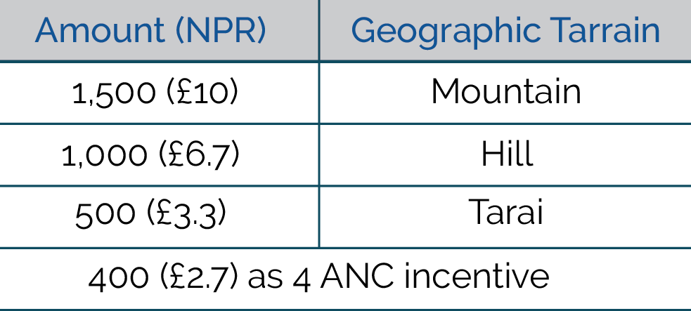
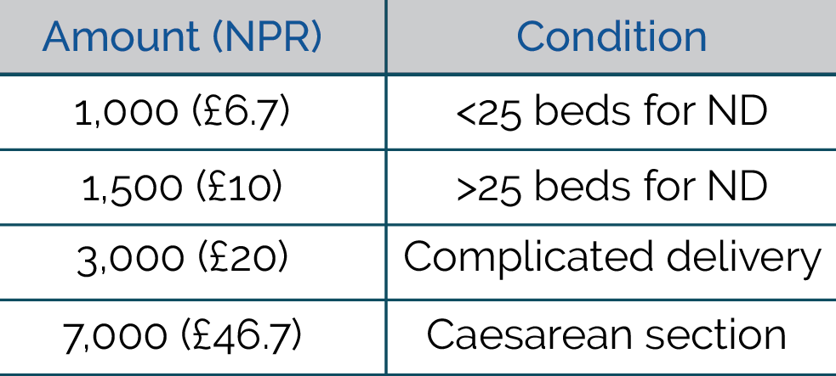
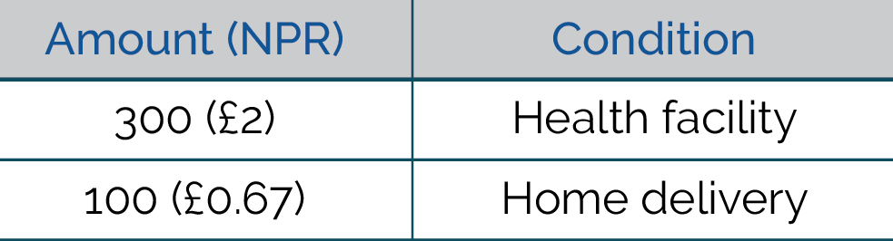
Aama Components
1. Incentive to women who
deliver in an institution
2. Unit cost to health facilities
reimbursed by delivery type
3. Unit incentive to health workers

Slide 34
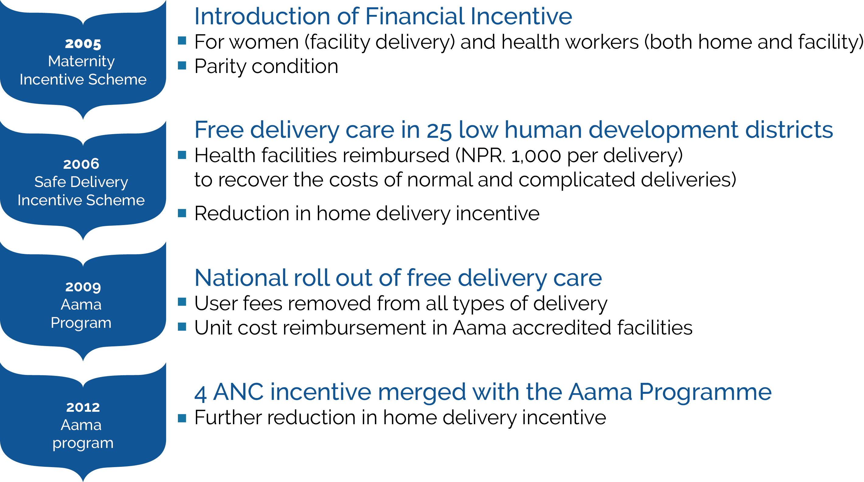
Aama Timeline

Slide 35
Evidence to Policy (E2P)
Financial cost of delivering in a health facility exceeds $80 and acts as a major barrier to women accessing delivery care
(Broghi et.al., 2004)
Estimated 24% increase in probability of a woman who is aware of the incentives delivering in a government institution
(Powell-Jackson et. al., 2008)
Rapid Assessments (RA) key to identifying management gaps - MoH has introduced 3 policy amendments.
In 25 low HDI districts with free delivery services institutional deliveries increased by 9.3% compared to 1.1% in elsewhere. . (HMIS-2008)

Slide 36
Top Line Findings: Aama Unit Cost Study, 2015
Current reimbursement rates are sufficient to cover direct costs for all types of delivery in both public and private facilities, different levels of care, level of facility and all geographic regions;
Current rates of reimbursement were not designed to offset indirect costs of delivery care;
Implementation of Aama in private facilities (except teaching hospitals as CSR) might not ensure value for money due to need to recover high indirect costs.

Slide 37
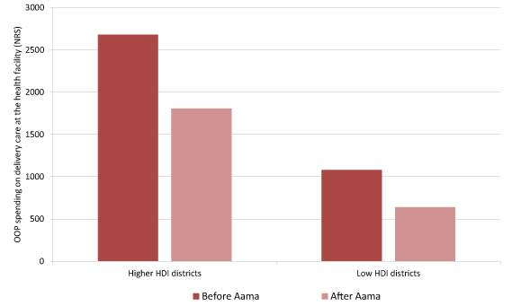
Aama has Reduced Out-of-Pocket
Spending in Health Facilities
Source: Aama, Early Evaluation, 2010

Slide 38
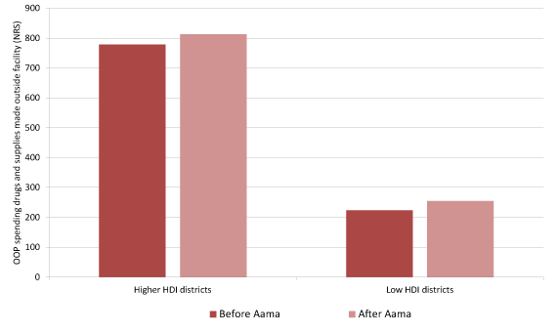
Spending on Drugs and Supplies Outside Facilities has Not Fallen with Aama
Source: Aama, Early Evaluation, 2010

Slide 39
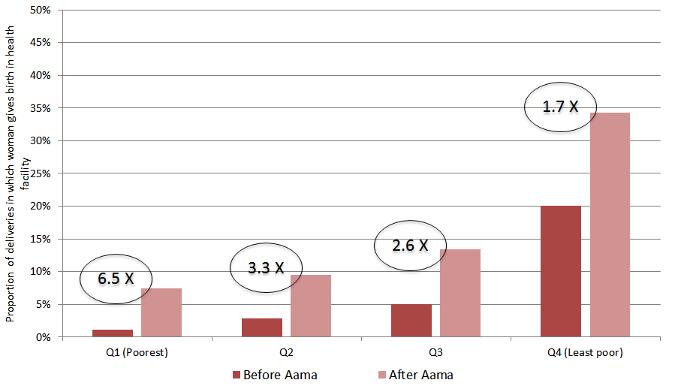
In low HDI areas, the poorest have seen the greatest increase in use of delivery care services since the start of Aama
Source: Aama, Early Evaluation, 2010

Slide 40
Contribution of Aama Surakshya Programme
Resolve Award in 2012 for innovative financing schemes managed by public sector
1.66 million women benefited since 2009
91% of entitled women received transport incentive
87% of women received service free of charge
Increase in number of participating facilities – from 543 in 2009/10 to 1,858 in 2015/16
57 non-state partners now providing Aama services

Slide 41
Policy Implications for NHSS (2015-20)
Key question – what costs should Aama cover to maintain and increase institutional delivery?
Public sector facilities receive a general budget for indirect and direct costs:
      1) Is this sufficient to cover indirect costs?
      2) Will the provider payment system change to cover indirect costs (e.g. case-based payment – DRG – proposed under the insurance system)
Private sector facilities must cover both direct and indirect costs so higher investment needed for indirect costs
Need policy integration with other social health protection programs

Slide 42
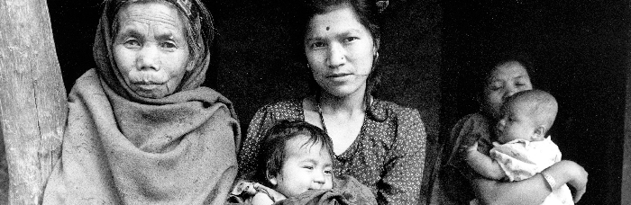
What does the Next Generation of Aama Look Like?

Slide 43
Transaction Accounting
and Budget Control System:
A National Initiative
in PFM Reform

Slide 44
PFM Related Issues Faced by MoH
Final accounts of MoH not prepared on time
Systems not comprehensive nor complete enough to report MoH’s actual financial position
Partial computerization worsened the timeliness and quality of accounting and financial reporting
Delays in preparing financial monitoring reports
Large number of activities - current FCGO coding system unable to capture spend

Slide 45
Why TABUCS
Improved accounting systems efficiency
Improved quality of accounting data
More robust budgetary control
Reduced workload and time saving
Better compliance with Right to
Information requirements

Slide 46
What is TABUCS?
Processing of Expenditures and Payments
Automatic Posting of Payments to Ledger Accounts and Summary Accounts
Processing of Cash and Bank Receipts and Revenues
Automatic Posting of Receipts to Ledger Accounts and Summary Accounts
Automatic Posting in Cash and Bank Books
Generation of All Ledgers and Accounting and MIS reports (including FMRs)

Slide 47
Features of TABUCS
Web Based System
Online and Offline System
Activity Wise Transaction Accounting System
Both in English and Nepali Language
Central Level Control on Annual Program Budget, Authorization, Salary Scale
Flexible User Rights Management

Slide 48
TABUCS System Environment
Database: MS SQL Server 2012
Server Side Language: ASP
User Interface: DHTML with AJAX

Slide 49
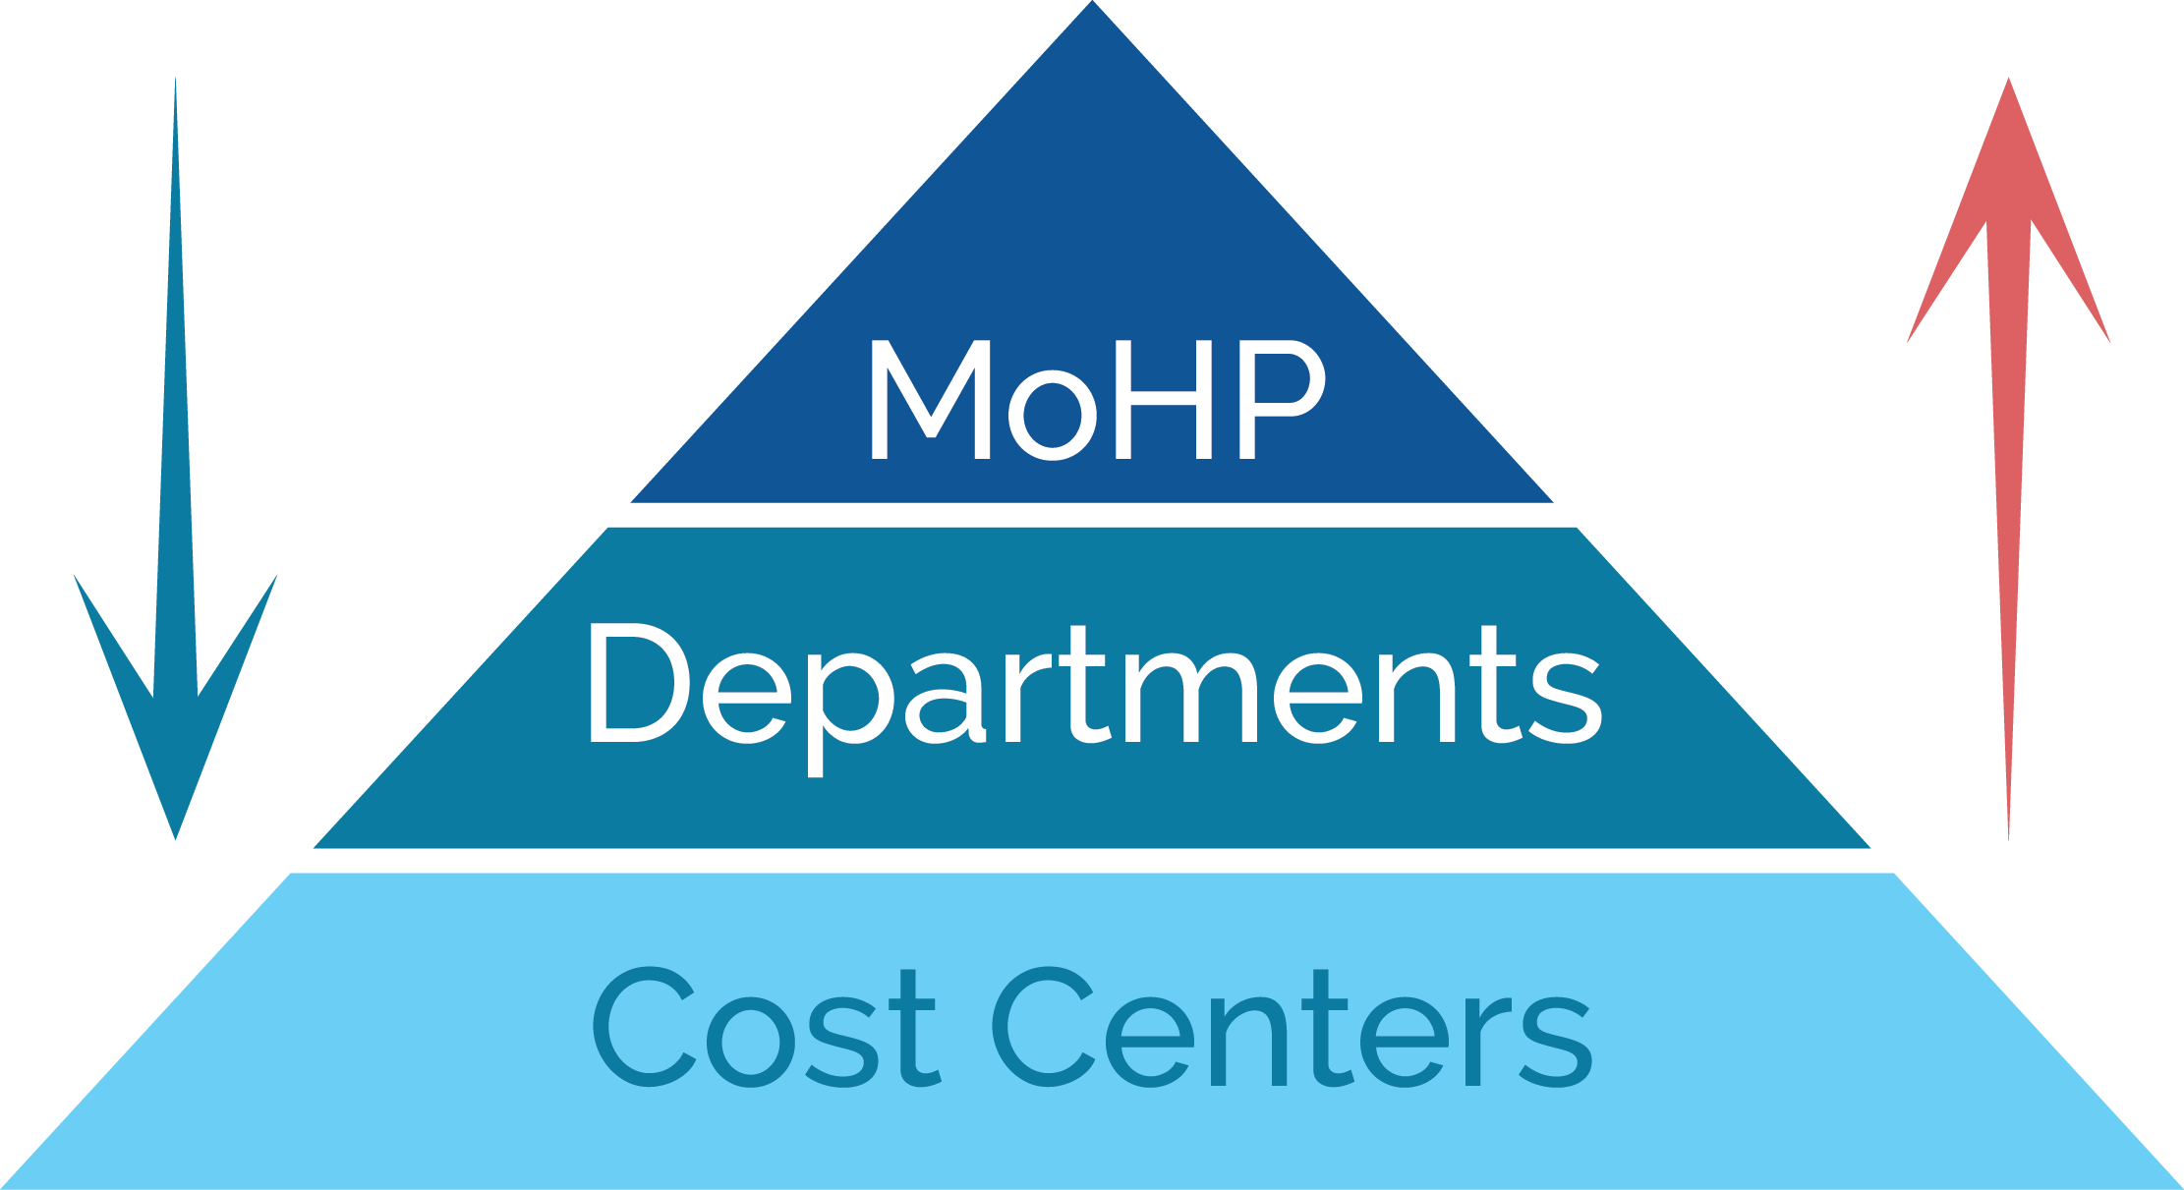
Data / Information / Funds Flow

Slide 50
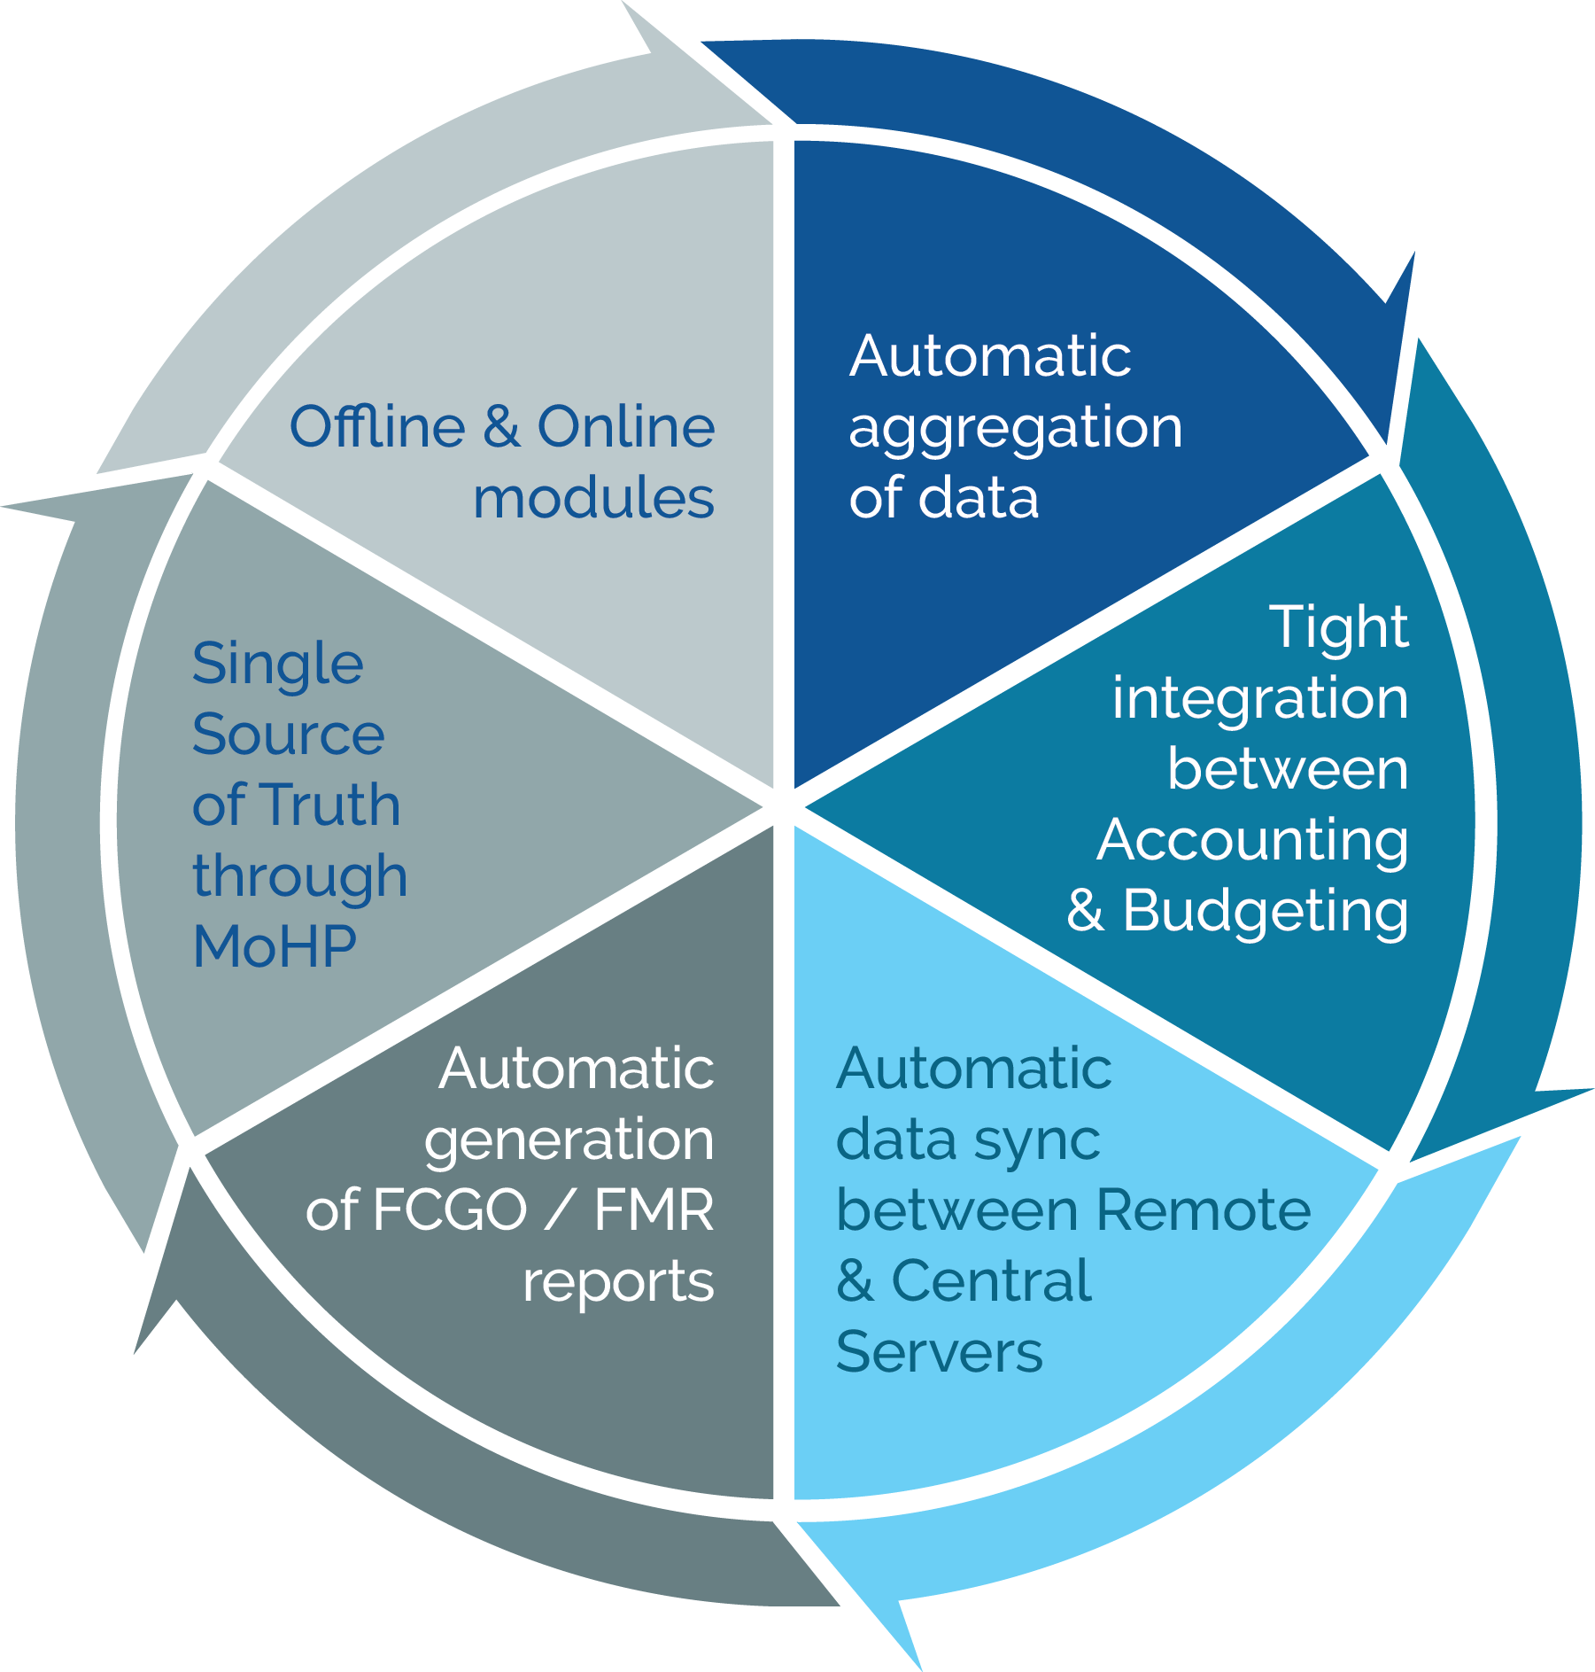
Essential Design

Slide 51
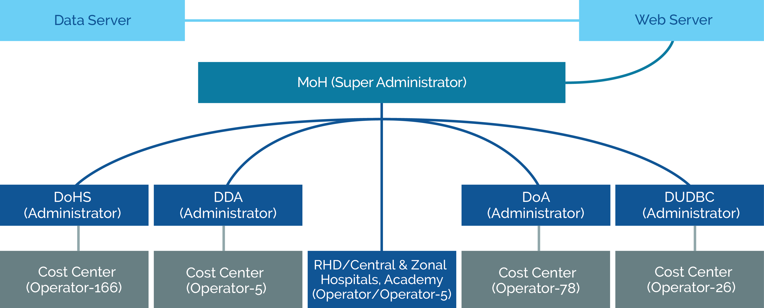
TABUCS Flow Chart

Slide 52
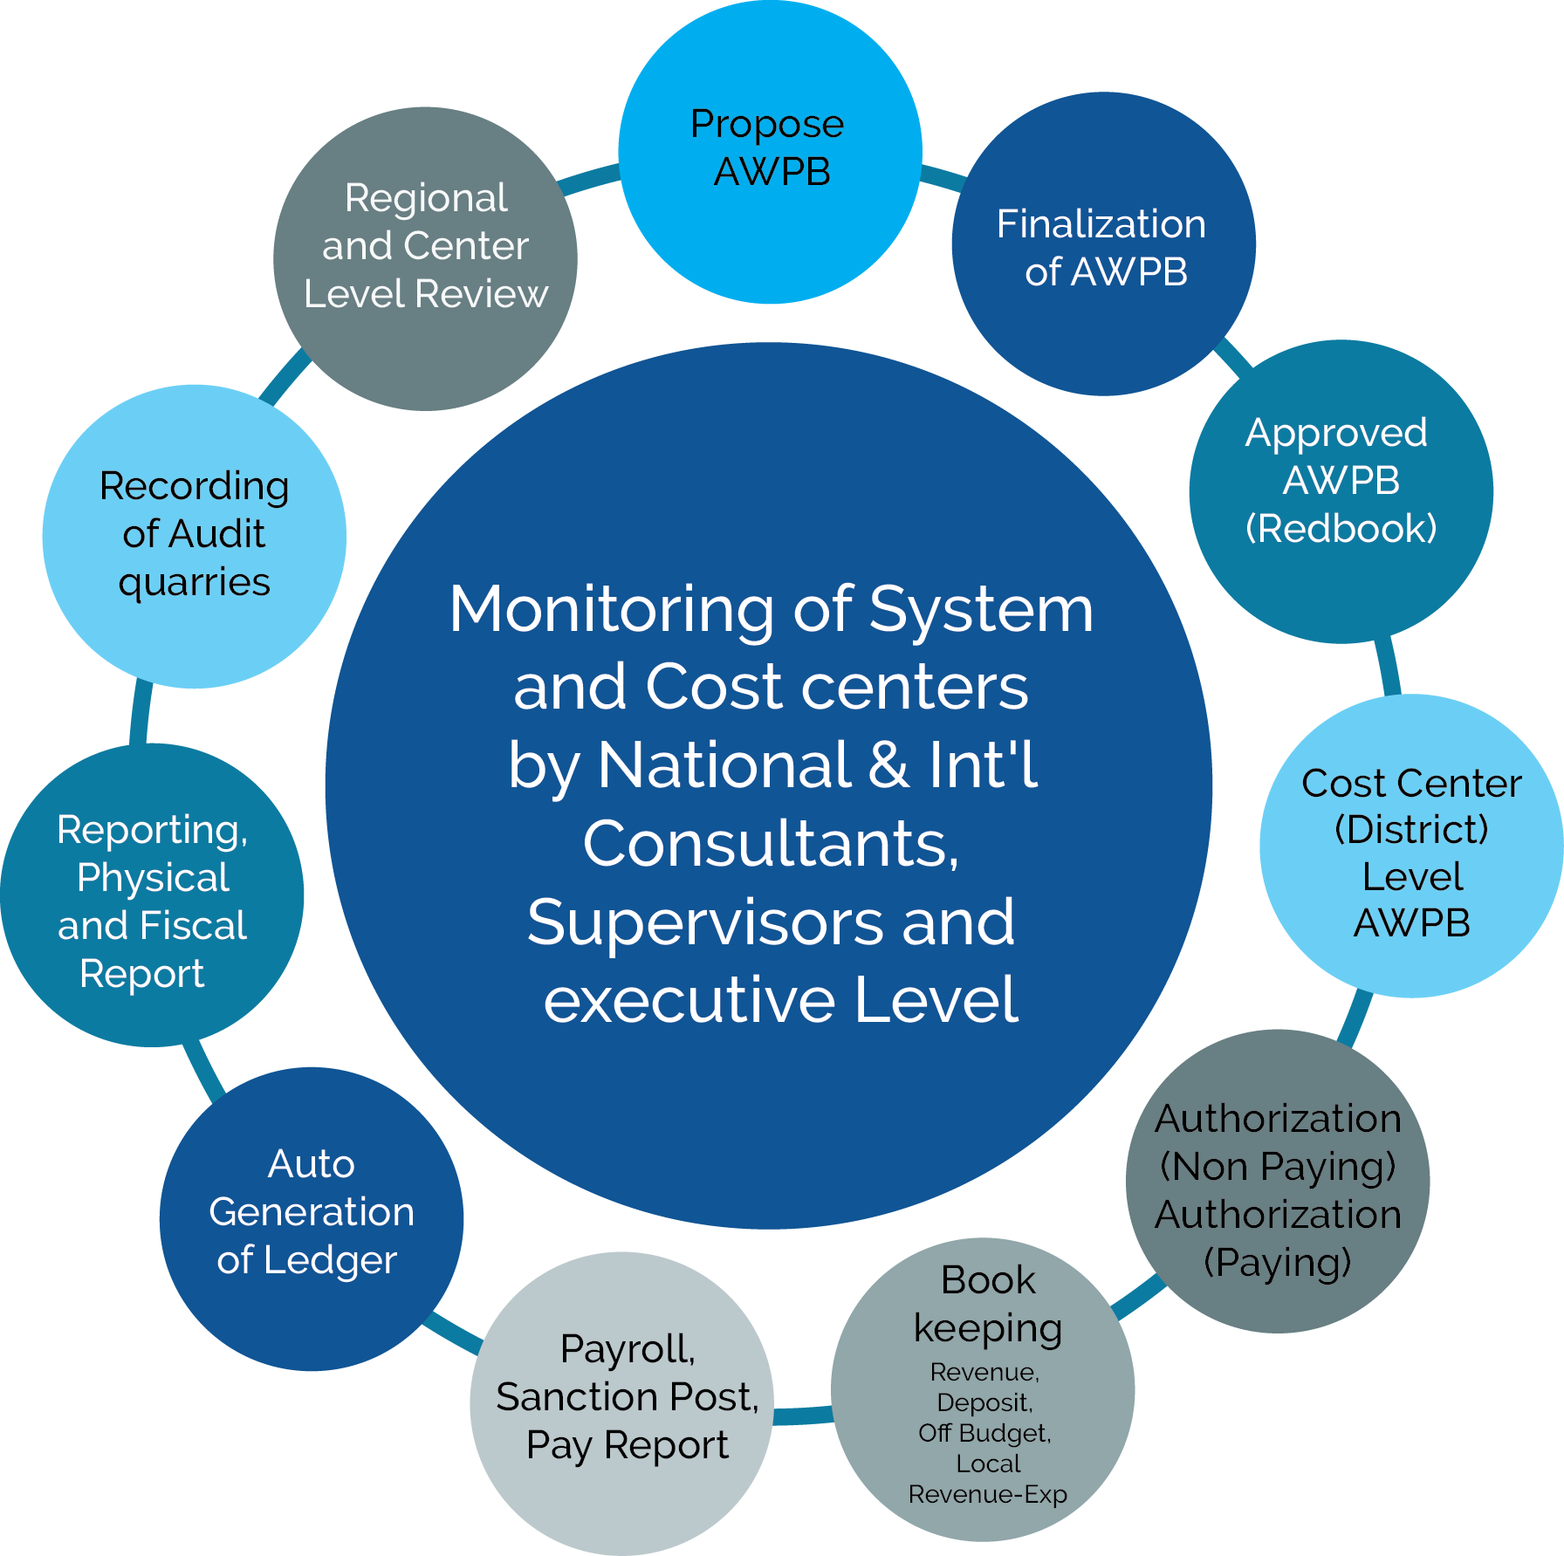
TABUCS Cycle

Slide 53
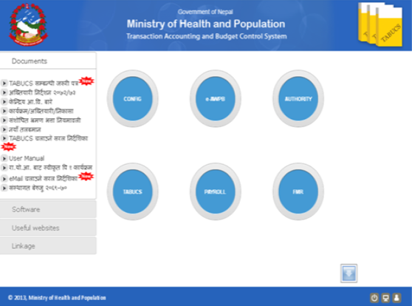
Modules in TABUCS
Configuration
e-AWPB
Authorization
TABUCS
Payroll
FMR

Slide 54
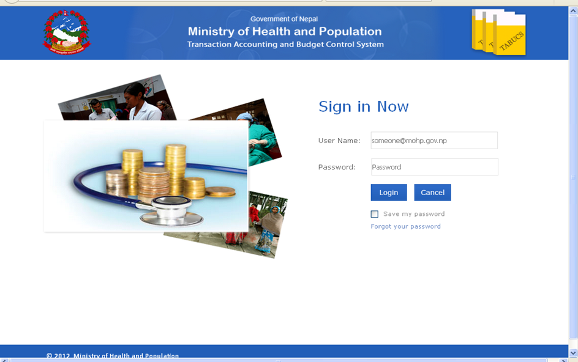
Lets Log Into TABUCS

Slide 55
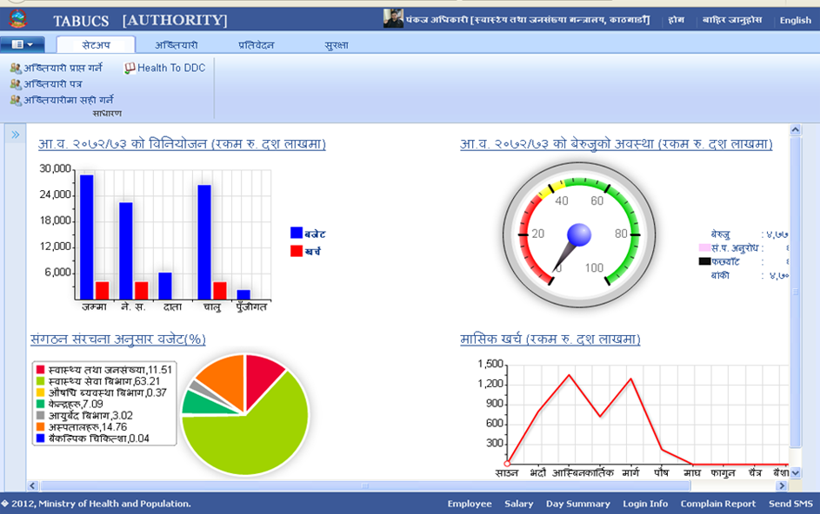
Dash Board

Slide 56
Configuration
Define Business Rules
Define Common Values
Register Offline Version
Define User Groups
Define Default Permission
Setup Data Sharing APIs
Configure SMS Gateway
View System Environment Reports

Slide 57
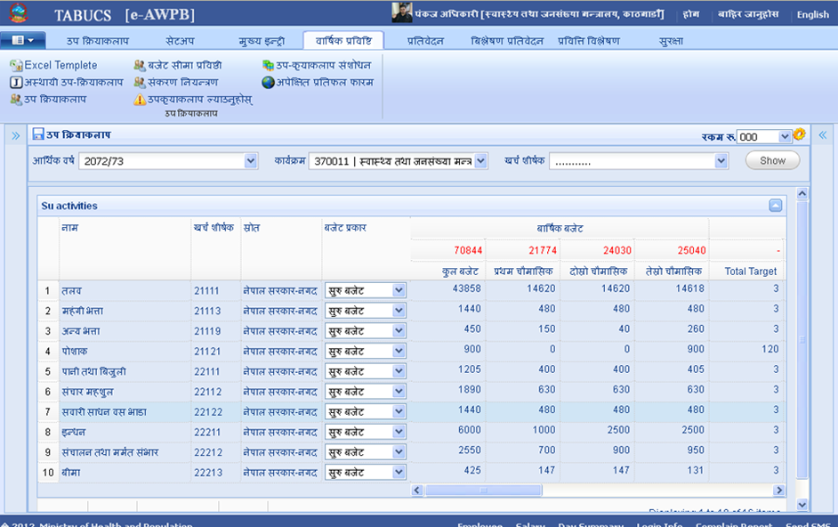
e-AWPB

Slide 58
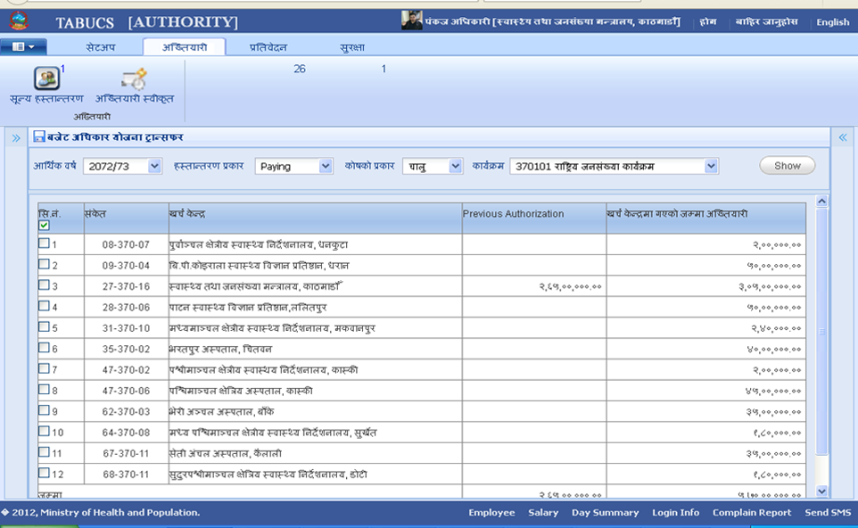
Authorization

Slide 59
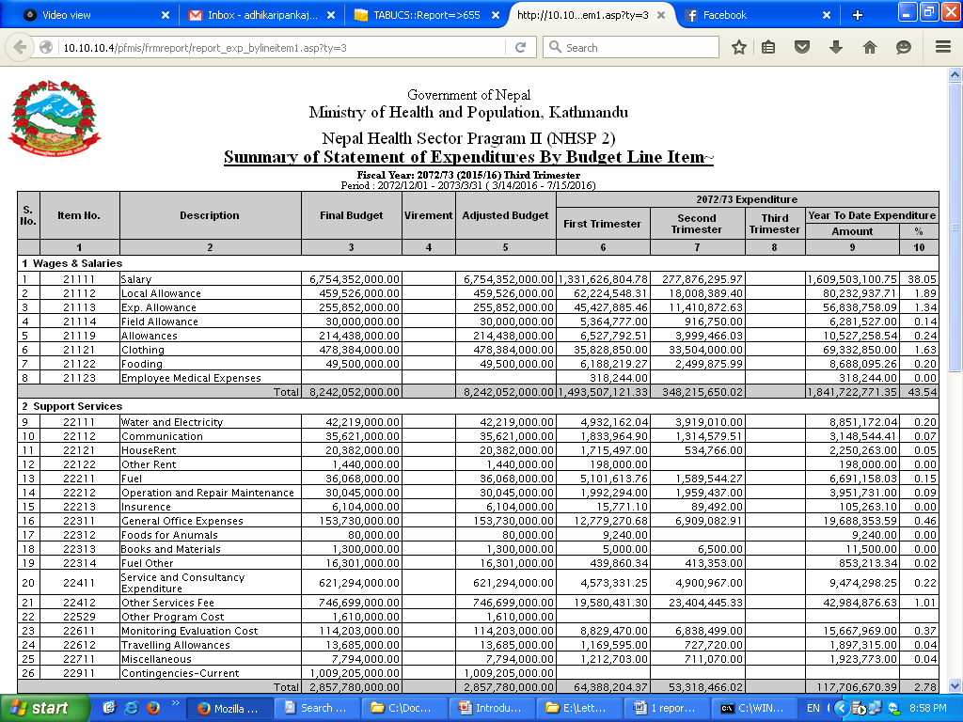
TABCUS Can Now Generate FMR

Slide 60
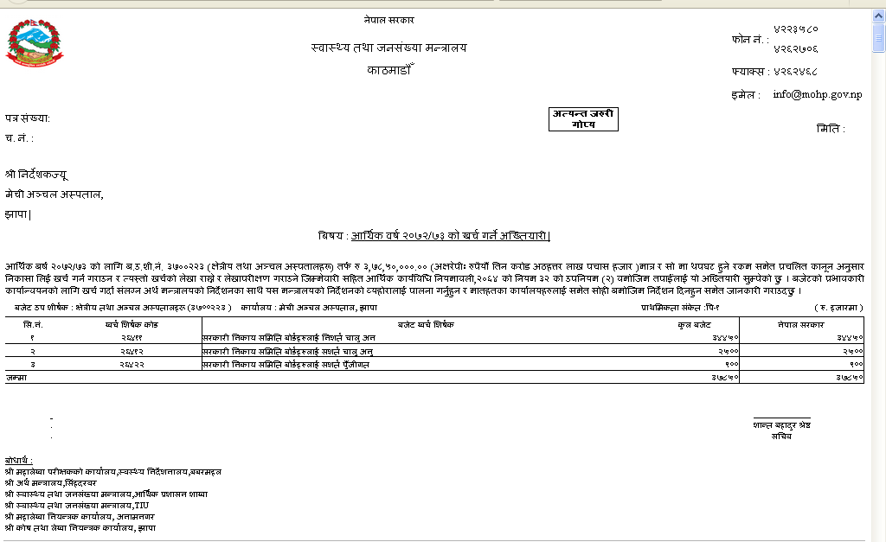
Authorization Letter

Slide 61
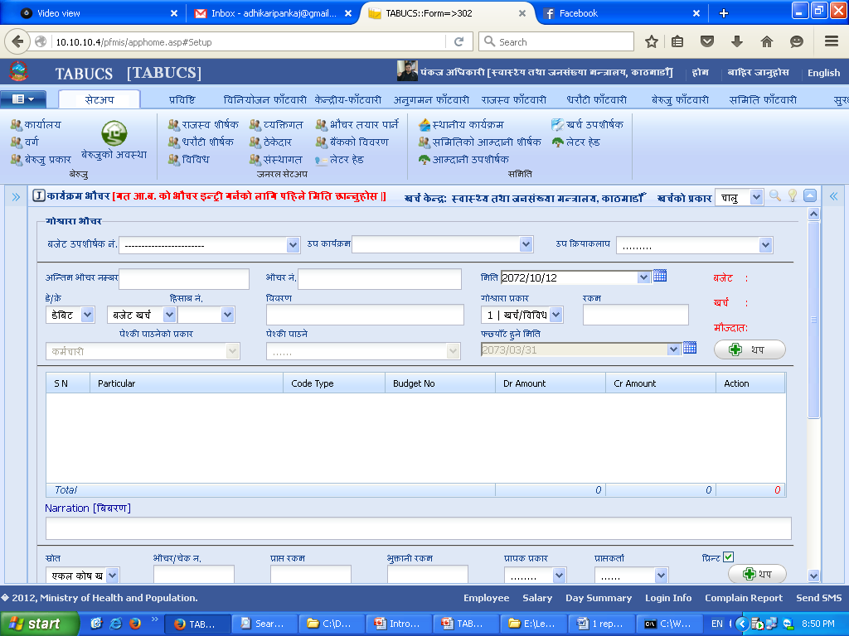
Voucher Entry

Slide 62
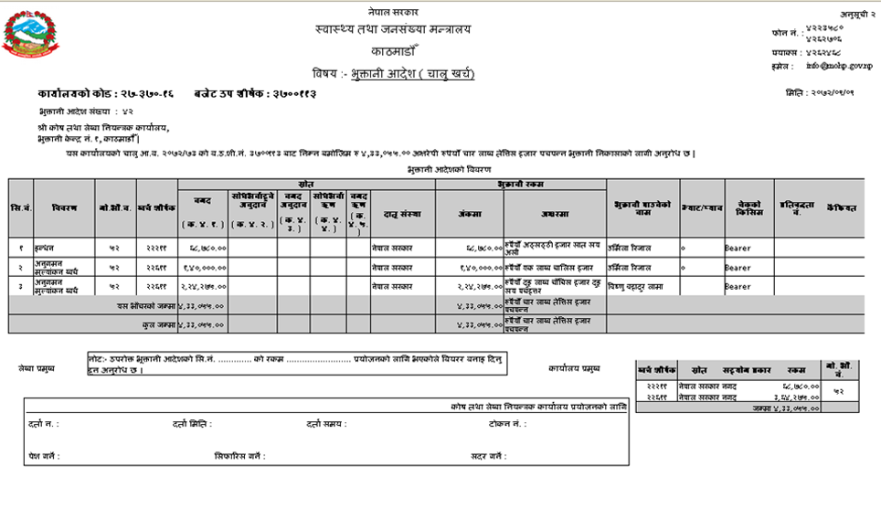
Payment Order

Slide 63
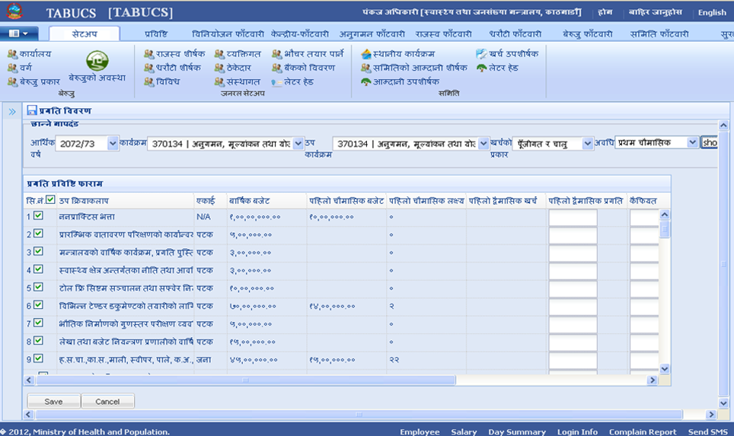
Progress Entry

Slide 64
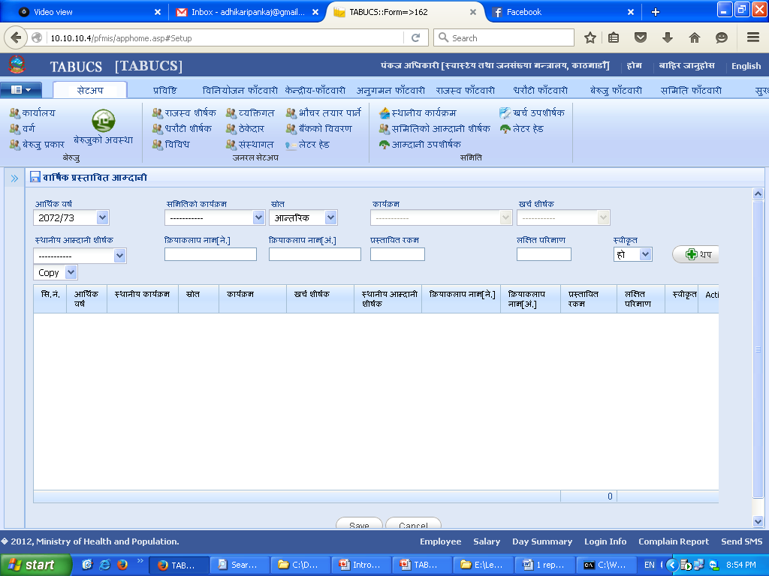
Local Revenue in TABUCS

Slide 65
Contribution of TABUCS
FY | Time | Period | Due Date | Prepared Date | # of Days Taken
2012/13 | 1st | July to Nov | 12-Dec | 15-Feb-13 | 76
 | 2nd | Nov to March | 13-Apr | 20-Sep-13 | 172
 | 3rd | March to July | 13-Aug | 26-Nov-13 | 117
2013/14 | 1st | July to Nov | 13-Dec | 7-Feb-14 | 68
 | 2nd | Nov to March | 14-Apr | 28-Jul-14 | 118
 | 3rd | March to July | 14-Aug | 10-Dec-14 | 131
2014/15 | 1st | July to Nov | 14-Dec | 14-Nov-14 | -17
 | 2nd | Nov to March | 15-Apr | 26-Mar-15 | -6
 | 3rd | March to July | 15-Aug | 22-Aug-15 | 21

Slide 66
Way Forward
Community of Practice: develop a community of practice to share the system of accounting and financial management with other line ministries and countries
The next generation: allow cost centres to enter independently generated revenue receipts to allow for bottom-up planning and efficient fund allocation
Reform-based: reform should be integrated into the system as suggested by the built-in monitoring and evaluation features
Institutionalise TABUCS: create a permanent section within MoH to monitor functionality of the system

Slide 67
Thank you

Slide 68
Infrastructure Planning and Procurement

Slide 69
Inputs: Guidelines for Infrastructure Planning
Introduction of Guidelines for selection of health facilities for new construction and for upgrading
Introduction of Land Selection Criterion for selecting land for construction of new health facilities

Slide 70
Outputs
Site selection more rational and evidence based
Selection of sites with larger catchment areas and better accessibility, linked to several settlements.
More appropriate site selection
  reduced land development costs
  sites better sized and accessible
  Improved access to utilities
More HFMCs acquiring new lands for HF construction as per the guidelines as a result of strict enforcement of the land selection criteria.

Slide 71
Inputs: Capacity Building in Procurement Planning and Procurement of Civil Works
Preparation of consolidated annual procurement plan (CAPP) for civil works.
Regular monitoring of progress against CAPP.
Standard bidding documents incl. preparation guidelines developed and distributed to all the DUDBC offices across the country.
E-bidding system introduced and institutionalized for procurement of civil works
Increased joint monitoring

Slide 72
Outputs:
International competitive bidding (ICB) introduced.
Uniformity achieved in bidding documents across all the division offices; process institutionalized.
Computerized progress reporting system in place in DUDBC
Improved preparation of CAPP; timely submission and approval
Improved construction completion rates with DUDBC taking punitive actions against delinquent contractors
DUDBC increases div. offices from 25 to 35.
e-bidding reduced price of new contracts by avg. 12%.

Slide 73
Health Infrastructure Information System (HIIS)
HIIS GIS enhanced for more evidence based planning and as a web based system
Geographic coordinates of all health facilities including all upgraded health post entered,
Facility spatial dimensions added.
60 % of upgraded HPs information collected for the upgraded HIIS using mobile technology
HIIS training for district technical staff in all five regions carried out to update records and verify GIS facility coordinates.

Slide 74
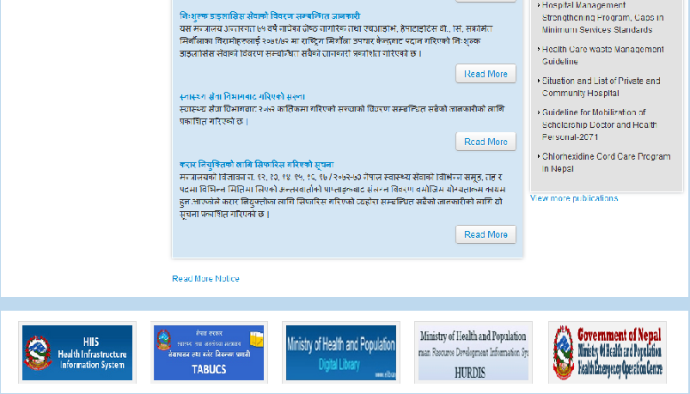
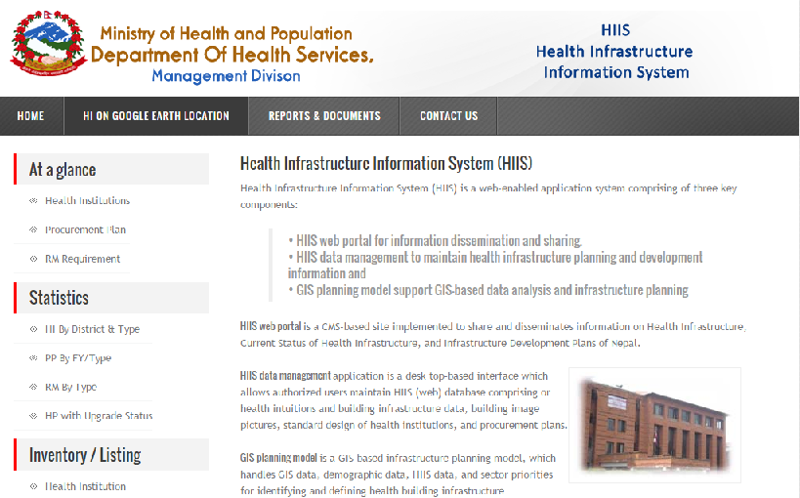
Health Infrastructure Information System (HIIS) - Online
The HIIS has been integrated with web components to disseminate the health facility infrastructure details (Geographic location, Institutional details, building block details) over the public domain via internet.
The online component can be accessed via MoHP website http://mohp.gov.np/ by clicking the HIIS banner in the bottom of the homepage.
The HIIS web component can also be accessed via direct link http://hiis.delveis2.com

Slide 75
Output:
Annual selection of facilities for new construction or upgrading by Management Div. carried out using HIIS.
Many other organization using HIIS data for planning.
Delineation of location of tertiary and secondary level hospitals using HIIS proposed
Very useful for preparing maps and methodology during detailed assessments of health facilities following earthquake.

Slide 76
Development of Integrated Standard Designs and Guidelines for Construction of Health Facilities
The assessment made to determine the VfM from Integrated Design showed that their introduction for new health facilities has reduced the average construction cost per square metre by an estimated 16%.

Slide 77
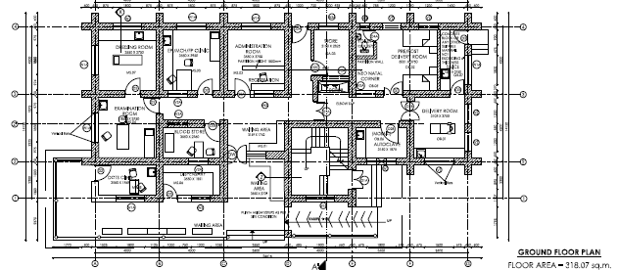
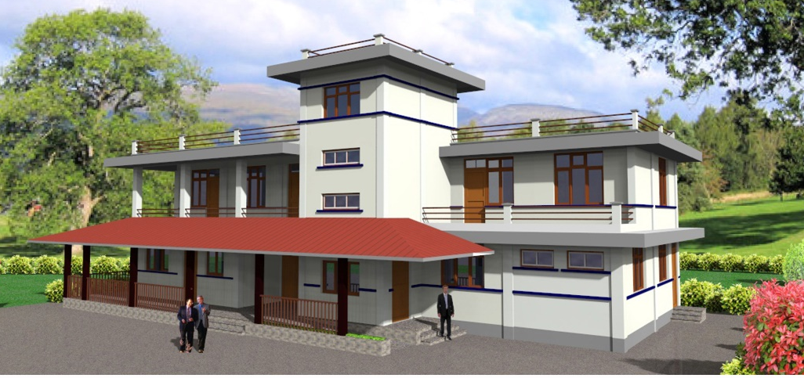
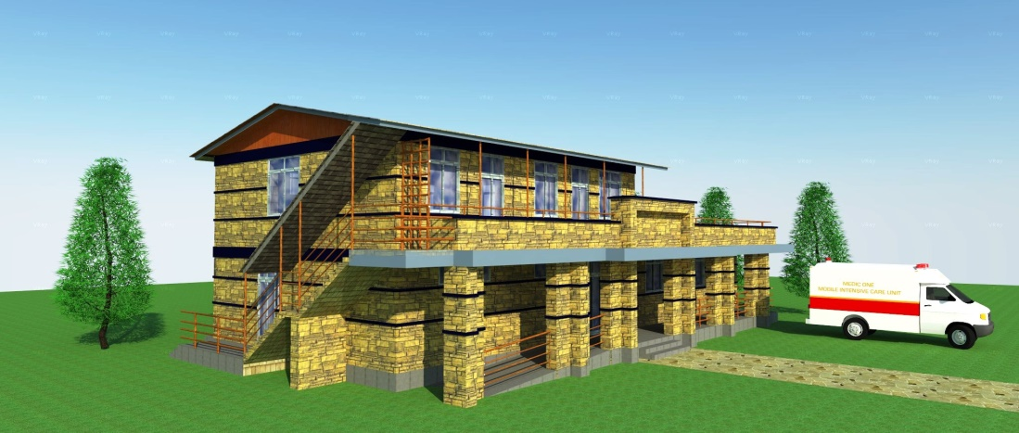
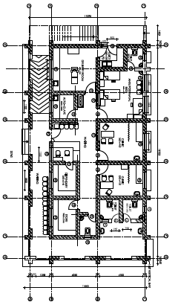
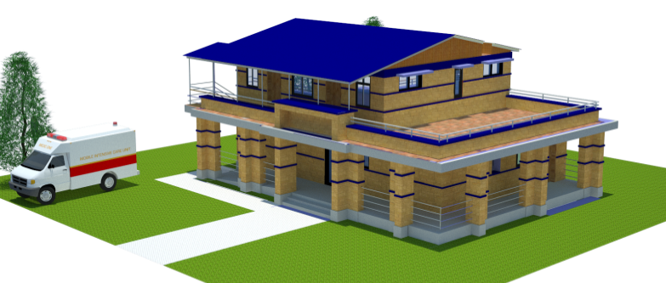
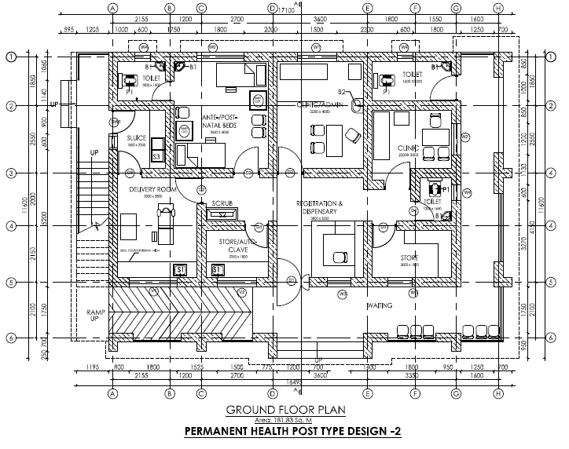
HP STANDARD TYPE
HP STANDARD TYPE-1
STANDARD HEALTH POSTS TYPE DESIGNS
STANDARD TYPE = 520 sqm.
STANDARD TYPE -1 = 375 sqm
STANDARD TYPE -2 = 270 sqm.
HP STANDARD TYPE-2

Slide 78
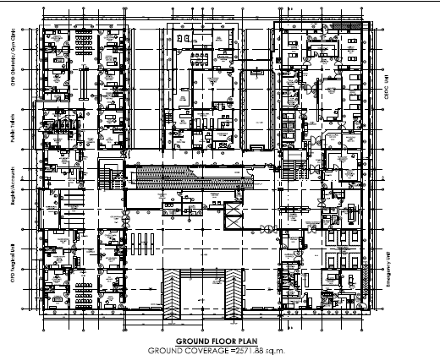
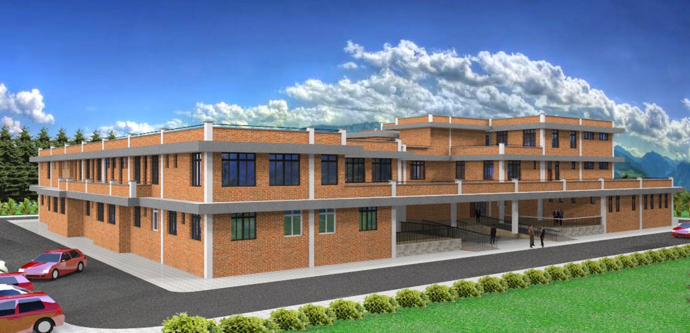
STANDARD TYPE DESIGNS FOR DISTRICT HOSPITAL
51-70 BED = 5020.85
31-50 BED = 3341.23
15-30 BED = 2525.85

Slide 79
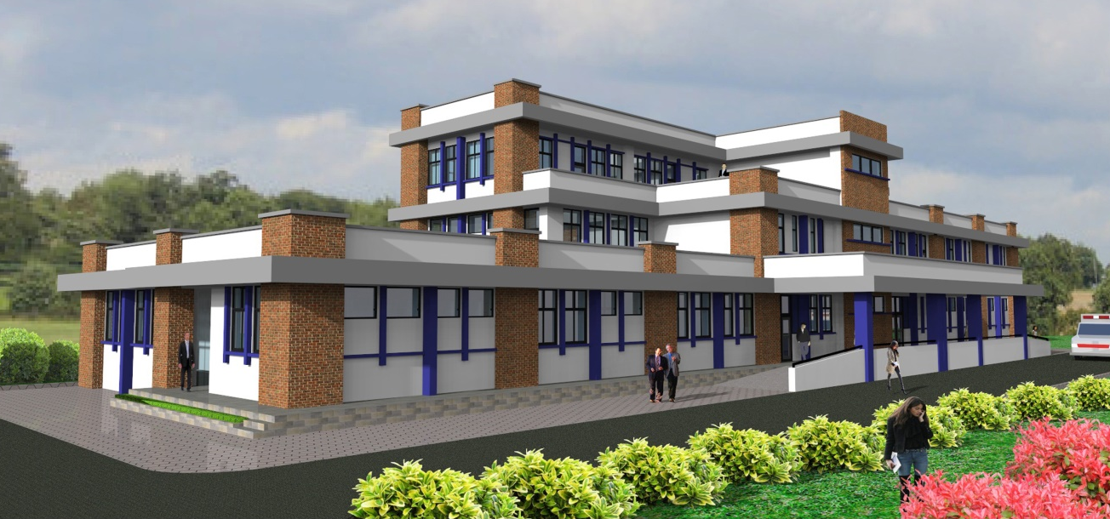
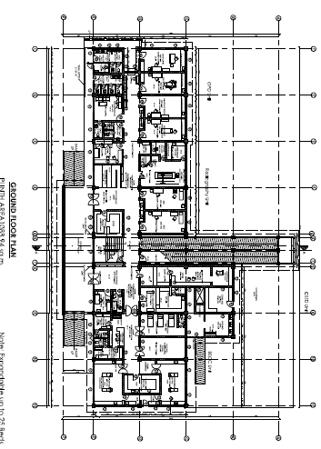
STANDARD TYPE DESIGNS FOR PRIMARY HEALTH CARE CENTER
15 BED = 2046.73
10 BED = 1258.24

Slide 80
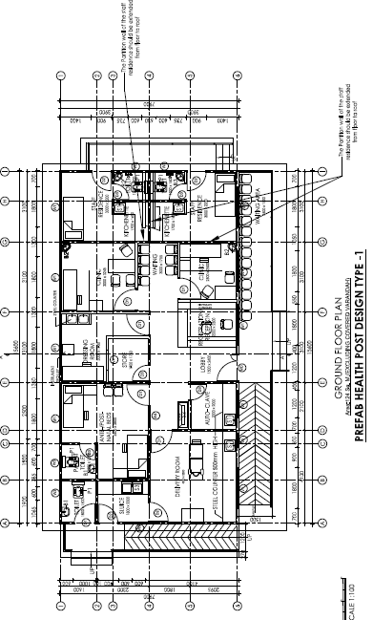
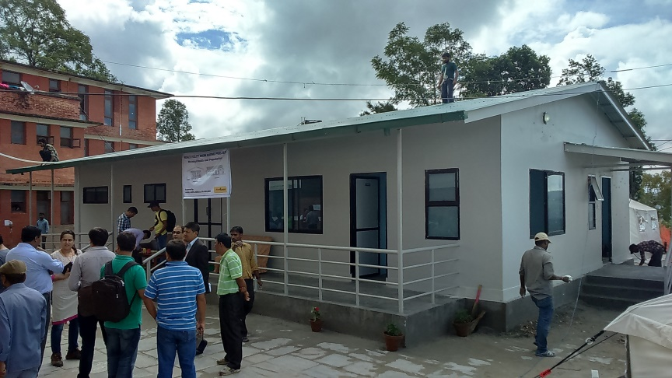
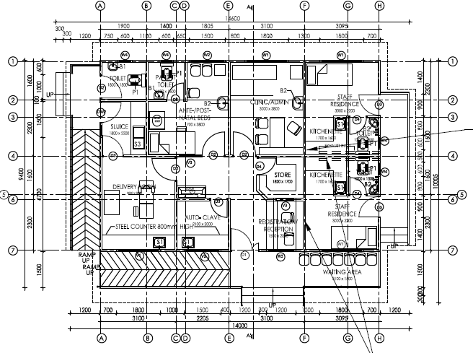
STANDARD TYPE DESIGNS FOR POST-EARTHQUAKE RECONSTRUCTION
HEALTH POST – TYPE 1
HEALTH POST – TYPE 2
PRE-FAB HEALTH POST – TYPE 2

Slide 81
Rehabilitation/Construction/Expansion of Central, Zonal and Regional Hospitals
Multi-disciplinary team formed for assessment and design of Bheri, Seti and Surkhet Hospitals.

Slide 82
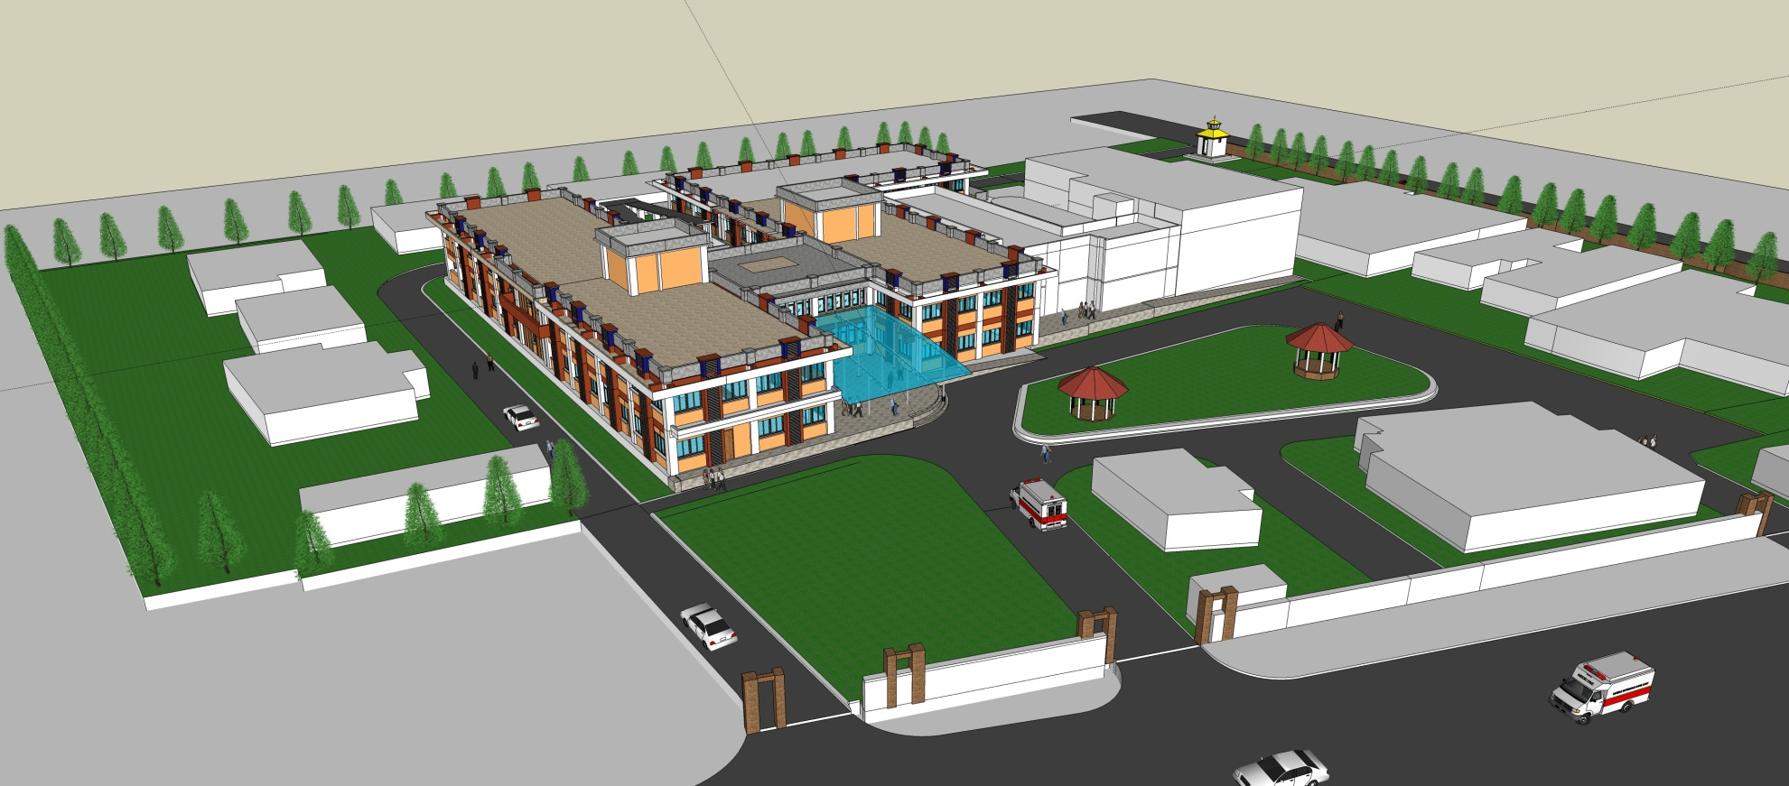
Seti Zonal Hospital

Slide 83
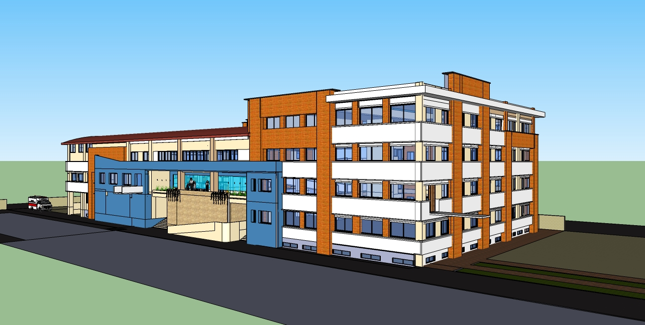
Gangalal OPD

Slide 84
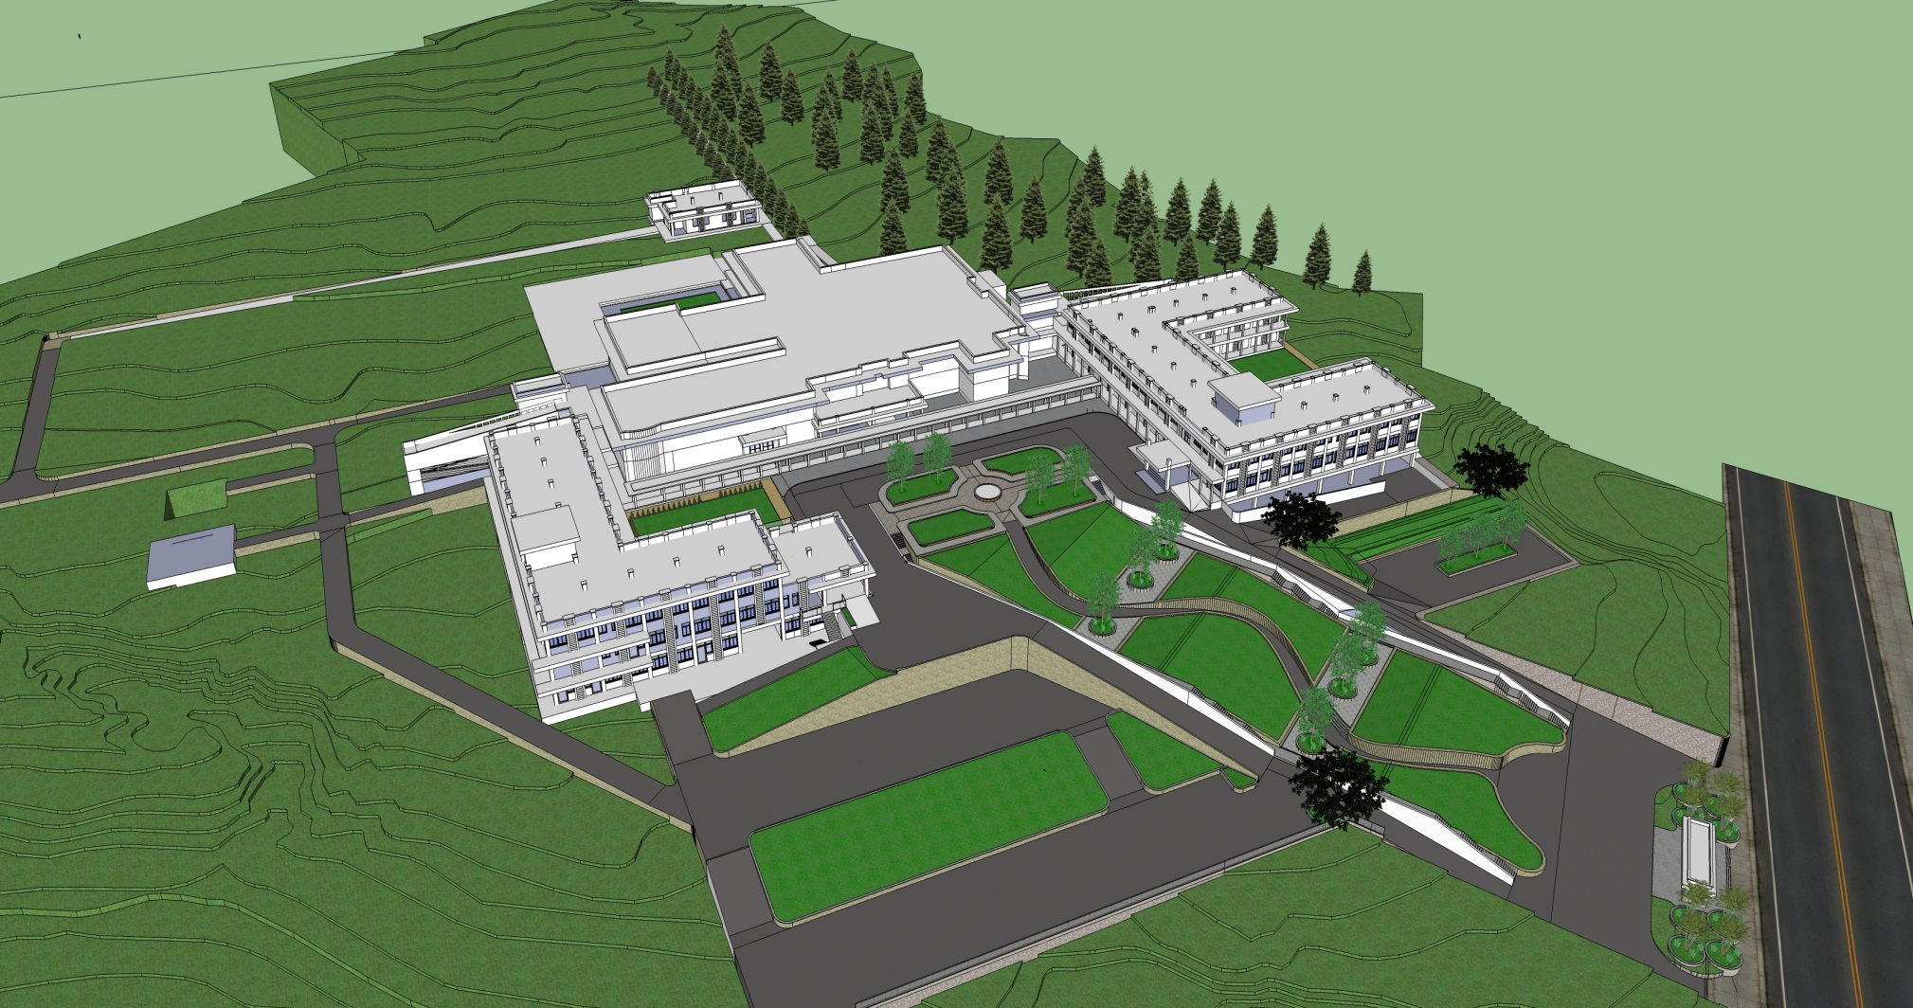
Surkhet Regional Hospital

Slide 85
Procurement: Contract Management System (CMS)
Electronic CMS developed by LMD to help evaluate bids and track procurement status
CMS links to DoHS finance, DoHS divisions, regional/central LMD warehouses and contract managers.
System generates reports on delivery status to warehouse and demand forecasting (pipeline report).
Now rolled out nationally with support from H4L.
Extensive training to LMD staff on CMS, procurement +.

Slide 86
Web-based Technical Specifications Bank
Technical specification bank developed by LMD to improve the quality and efficiency of procurement
1532 entries (472 pharmaceuticals and 1060 equipment).
Value for money case study showed minimum return of £2.6 for every £1.0 invested
Over 2000 user downloads from Nepal and SAARC region.
Regional support to strengthen supply chain management (cold chains; warehouses, DHOs etc) also provided.

Slide 87
Procurement Reform
Procurement reform concept paper developed and endorsed by MoHP to be taken forward under NHSS (2015-20)
O&M study linked to procurement reform planned
Consolidated annual procurement plan (CAPP) introduced and prepared for last 3 years leading to improved procurement efficiencies through bulk purchase and economies of scale.

Slide 88
Thank you

Slide 89
Gender Equality and Social Inclusion (GESI)

Slide 90
Overview
Integrating GESI into the health system
Gender based violence (GBV): One Stop Crisis Management Centres (OCMCs)
Social Service Units (SSUs)
Social auditing

Slide 91
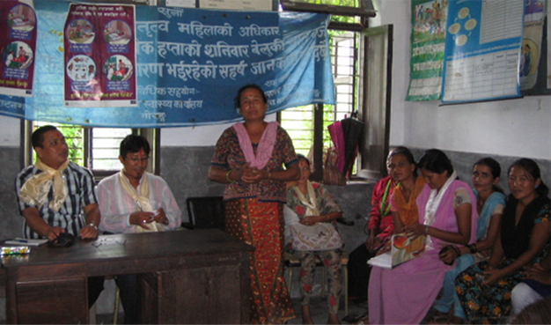
Integrating GESI into Health System: Why?

Slide 92
Key Inputs
Technical assistance and financial support to:
Design and operationalise institutional structure for integrating GESI in health sector.
Develop GESI Operational Guidelines to implement MoH GESI Strategy.
Train and orientate MoH and DoHS GESI focal persons, Regional Directorates, district supervisors, and D/PHOs.
Integrate GESI into NHTC's in-service training curricula; capacity building of NHTC and RHTC staff.
Integrate GESI into the revised HMIS.

Slide 93
Major Achievements
Institutional structure:
Functioning of an institutional structure for integrating GESI from centre to facility level.
Policy and planning:
GESI and equity integrated into policies and operational guidelines including: National Health Policy, Urban Health Policy, Population Policy, Nepal Health Sector Strategy.
Progress made in integrating GESI into business plans and AWPBs.
.

Slide 94
Major Achievements
GESI into practice:
Development and use of the GESI Operational Guidelines.
Increased attention to remote areas, GBV, and free care.
Inclusion of disaggregated data for specific indicators in the revised HMIS.
Capacity building:
NHTC and RHTC delivering GESI training as part of in-service training programmes.
GESI training rolled out across 31 districts.

Slide 95
Way Forward
Programming and service delivery for equity and GESI:
Integrate stronger focus on gender and social equity: remote areas, non-remote left-out populations, behaviour change communication.
Improve evidence of impact of social protection schemes and harmonise where viable.
Human resources for health:
Fill staffing gaps esp. in remote & underserved areas.

Slide 96
Way Forward (cont’d)
Institutional structure and capacity for GESI:
Strengthen structures and capacities to institutionalise GESI: build the capacity of GESI Section and focal persons, roll out GESI district training, integrate GESI into pre-service education
Social determinants of health:
Increase multi-sectoral collaboration to address social determinants of health.
Operationalise commitment to work with MoFALD on inclusive local governance and social mobilisation for health.

Slide 97

GBV and OCMCs: Why?

Slide 98
Key Inputs: OCMCs
Technical assistance and financial support for:
Development and revision of OCMC guidelines.
Technical backstopping and strengthening through training (psychosocial counselling and medico-legal training) and mentoring.
Development of GBV clinical protocol.
Development of integrated (multi-sectoral) national guidelines for services to GBV survivors (draft).
National reviews and workshops to plan OCMC direction.

Slide 99
Major Achievements: OCMCs
Service delivery
17 OCMCs in 2014/15. 4 more in 2015/16.
4420 GBV survivors received services (to mid Nov, 2015).
Increased capacity for GBV training (e.g. medico-legal and psycho-social counseling) to health staff and stakeholders
Developed and operationalized GBV clinical protocols.
Improved multisectoral response to GBV in centre and districts.
Policy level
Increased policy attention to GBV: e.g. MoH commit to 35 OCMCs by 2017/18 and roll out of GBV clinical protocol.
OPMCM called for the scaling up OCMCs across the country.

Slide 100
Way Forward: OCMCs
Service delivery:
Continue strengthening capacity of OCMCs and health services more broadly to serve GBV survivors. Prioritise medico-legal psycho-social training.
Integrate GBV servicces into health services through continued roll out of national GBV clinical protocol.
Develop GBV case follow-up mechanism.
Multisectoral coordination:
Complete integrated GBV guidelines for Cabinet approval.
Develop operational manual for integrated guidelines.

Slide 101
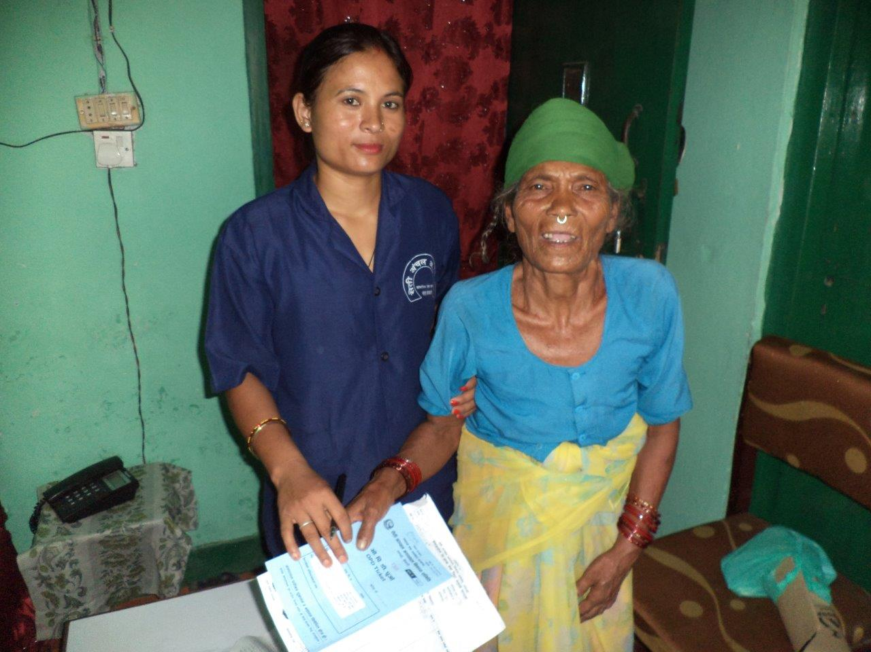

Social Service Units (SSUs): Why?

Slide 102
Key Inputs: SSUs
Technical assistance and financial support to:
Develop and revise SSU guidelines.
Support to implement 8 pilot SSUs.
On-going technical backstopping and strengthening.
Design software for SSU MIS with training.
Annual national reviews and develop a road map for the pilot.
Evaluate SSU pilot (2015) and prepare future road map.

Slide 103
Achievements: SSUs
Service delivery:
8 pilot SSUs operational.
103,289 clients received free or partially free services up to mid July 2015.
High patient satisfaction.
SSUs managed free care support to people injured by the earthquakes.
More accurate targeting of beneficiaries.

Slide 104
Achievements: SSUs
Management and efficiency:
Reduced workload of providers and managers in administering subsidies.
High cost-benefit ratio (1:41)
Increased access of poor and disadvantaged to referral hospital services.
MoHP committed to scaling up SSUs including 6 more in 2015/16.

Slide 105
Way Forward: SSUs
Service delivery:
Gradually roll-out SSUs to referral hospitals.
Harmonise SSUs with other hospital based social protection programmes.
Targeting:
Extend coverage to disaster affected populations and endangered and marginaised groups.
Standardise budgeting and entitlements:
Ensure earmarked budget based on hospital context (e.g. patient load, poverty incidence, prescribed benefit packages).
Define, standardise and enforce benefits packages (check-ups, investigation, medicines etc) to target groups.

Slide 106
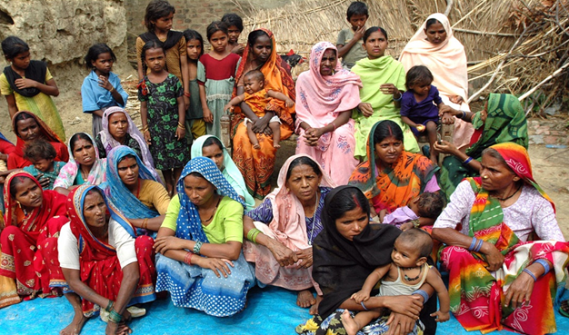
Social Audit (SA): Why?

Slide 107
Key Inputs: SA
Technical assistance and financial support to:
Develop and harmonise social audit guidelines.
Pilot and evaluate harmonised SA approach in Palpa and Rupendehi districts (2013).
On-going technical backstopping and strengthening through training and orientation.
Process evaluation (2015).

Slide 108
Major Achievements: SA
Implementation:
Social audits in 802 facilities across 45 districts.
Improved governance:
Improved access to services: increased Aama and ANC entitlements, longer opening hours; more staff.
Improved service quality: fewer stock outs, improved privacy
Improved accountability and management: display of Aama and ANC beneficiary names, more regular HFOMC meetings, more local initiatives to improve health services.
Key enabling factors:
Strong facilitation of the SA process by NGOs.
Commitment and involvement of D/PHO.
VDC participation and support for Social Audit Action Plan.

Slide 109
Way Forward: SA
Design and delivery:
Simplify SA process and tools based on evaluation (2015) and revise guidelines.
Improve the quality of training to partner NGOs.
Strengthen the supply side response:
Strengthen SA monitoring by DHO and links with DDC.
Increase capacity of PHCRD to manage and coordinate central level responses to local problems.
Harmonisation:
Design and test how health social audit can be harmonised with local government social auditing.

Slide 110

Thank you

Slide 111

Monitoring and Evaluation

Slide 112
Presentation Outline
General approach in strengthening M&E
Health Management Information System
Nepal Health Facility Survey

Slide 113
Collaborative Approach of Strengthening M&E
Increase availability and use of data
Strengthening routine information systems
M&E TWG
Networking with global community: UiO, HISP
Survey harmonization
Development and monitoring of NHSP2 RF
In-country capacity building
Use of ICT -
FOSS: DHIS2, OpenMRS
HMIS revision
NHSS 2015 -20 Results Framework
Multi-sectoral collaboration:
Nepal Police
Health Councils
EWARS:
Weekly bulletin;
DHIS2 customization
Move from MMMS 1998 & 2008/09 to MDSR
e-health initiatives:
e-reporting and e-recording
Review of health sector response to earthquake
Supporting MoH: working closely with partners

Slide 114
Strengthening of HMIS
Context
1993: Health Management Information System (HMIS)
1993 - 2011: Revisions to satisfy data needs of programmes
2005/06 - 2011/12: HMIS in 72 and HSIS in 3 districts

Slide 115
Strengthening of HMIS …
Inputs: Support Management Division for:
assessment of information systems esp. HMIS: 2010/11
HMIS revision: meet data needs; integrate vertical reporting; integrate HMIS & HSIS; improve quality and use of data: 2012/13
training of 75,000 health workers and volunteers: 2013/14
publication of reference materials
implementation of revised HMIS across the country: 2014/15
move towards Free Open Source Software (FOSS): DHIS2 and OpenMRS
printing and distribution of HMIS tools
move towards e-recording and reporting

Slide 116
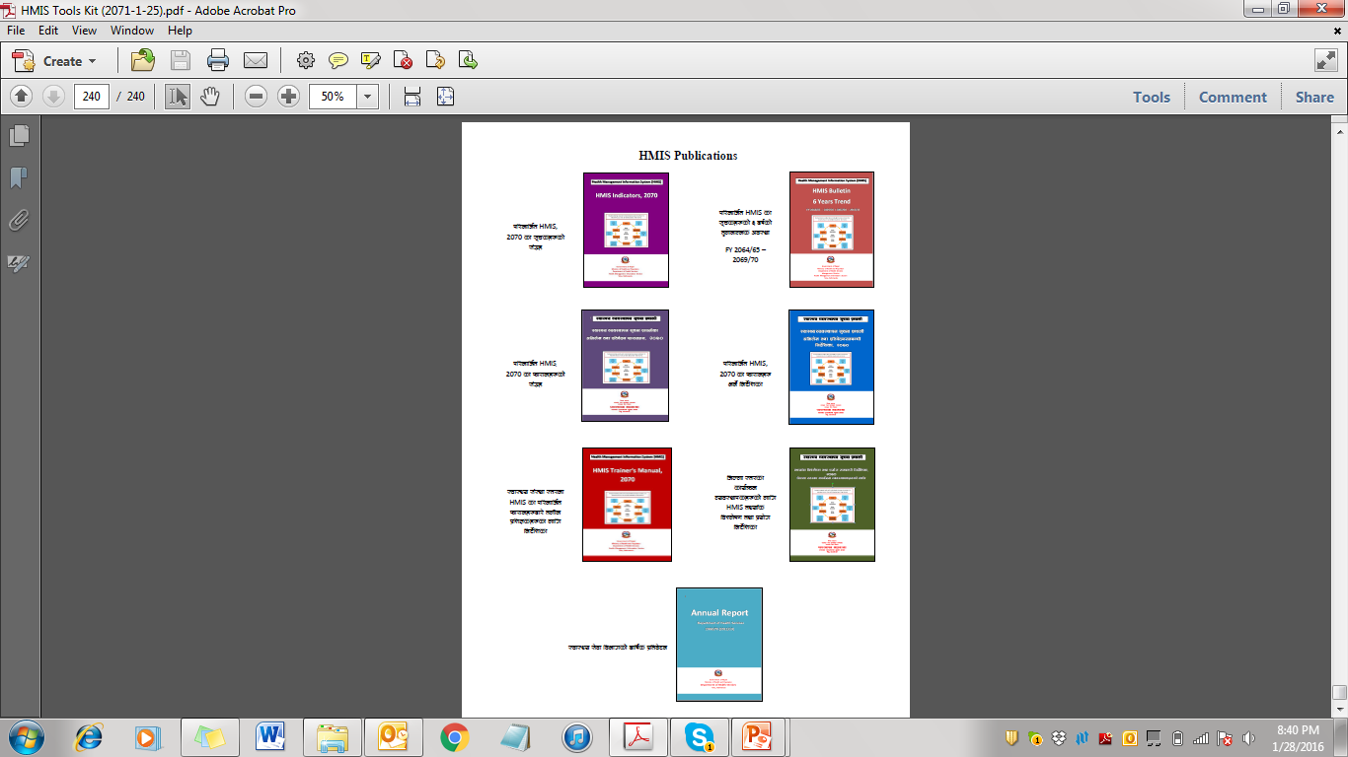


HMIS Publications…

Slide 117
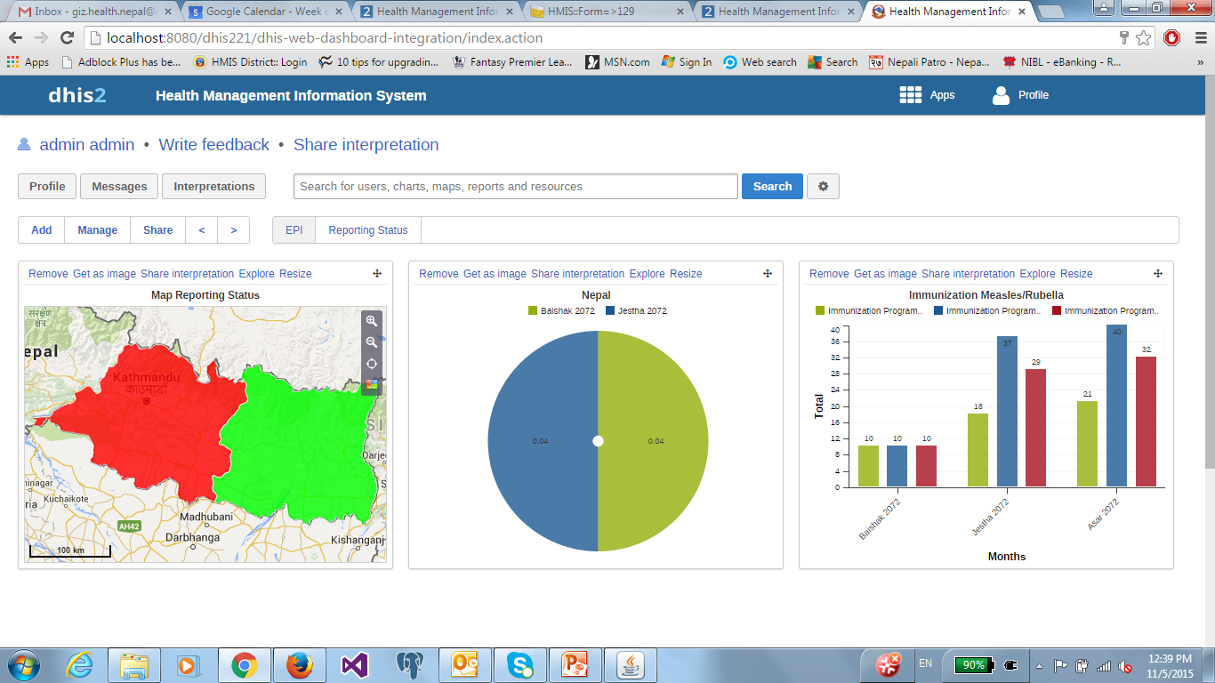
NepalDHIS Dashboard

Slide 118
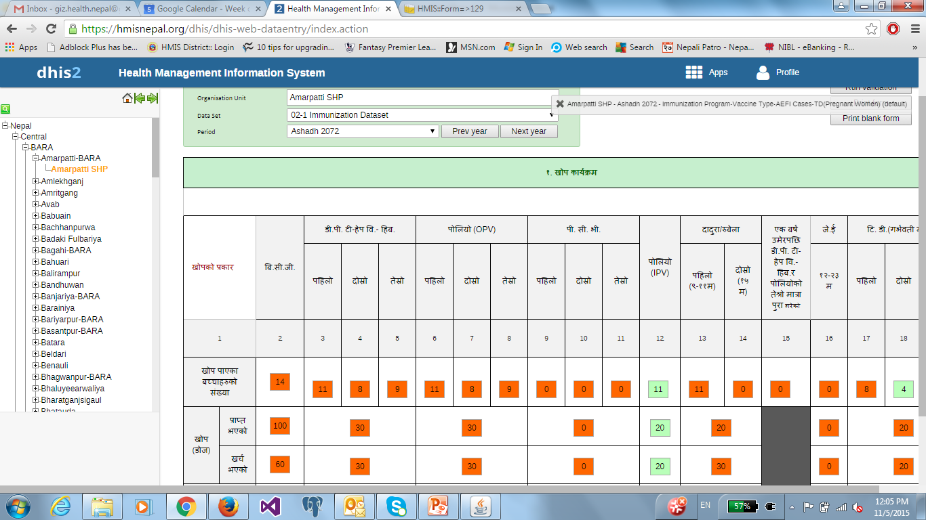
NepalDHIS: Data Entry Form

Slide 119
Strengthening of HMIS …
Outputs
Integrates vertical reporting systems: EoNC monitoring, Aama, CB-IMNCI, TB, HIV/AIDS
Establishes platform for improving quality and use of data at different levels, particularly at the point of generation
Resource harmonization: Co-funding from MoH and partners
Wider realization of move towards 'paperless' system
Institutional capacity building: customization of FOSS and roll out
Meets data needs of the health sector: GoN and supporting partners
Sets a sound base for improving data availability and use at different levels

Slide 120
Harmonization of Health Facility Surveys
Context
First and Second Trimester Health Facility Surveys by RTI: 2008 & 2009
Service Tracking Surveys, MoH/NHSSP/DFID: 2011, 2012 & 2013
Annual Facility Assessment for Reproductive Health Commodities Security (FARHCS), by UNFPA: 2011, 2012

Slide 121


Slide 122
Harmonization of Health Facility Surveys …
Inputs
Coordination with agencies and pooling of resources: MoH, USAID, WHO, DFID, UNFPA
NHFS 2015 builds on:
Service Provision Assessment (SPA), USAID
Service Availability and Readiness Assessment (SARA), WHO
Facility Assessment for Reproductive Health Commodities Security, UNFPA
Service Tracking Surveys, MoH/NHSSP/DFID

Slide 123




Nepal Health Facility Survey
Health Facility Level
Provider Level
Client Level

Slide 124
NHFS Outputs
Serves as baseline for NHSS 2015-20; guides the programme and helps monitor performance of the sectoral inputs
Supports institutional capacity building of MoH and local survey implementing agency
Allows international comparison
Sets a good example of harmonization of efforts of MoH and partners on a common goal
Provides a platform for developing a health sector survey plan in line with NHSS 2015-20
Preliminary report in February and final report in June 2016.

Slide 125
Thank You

Slide 126



